Slide 1
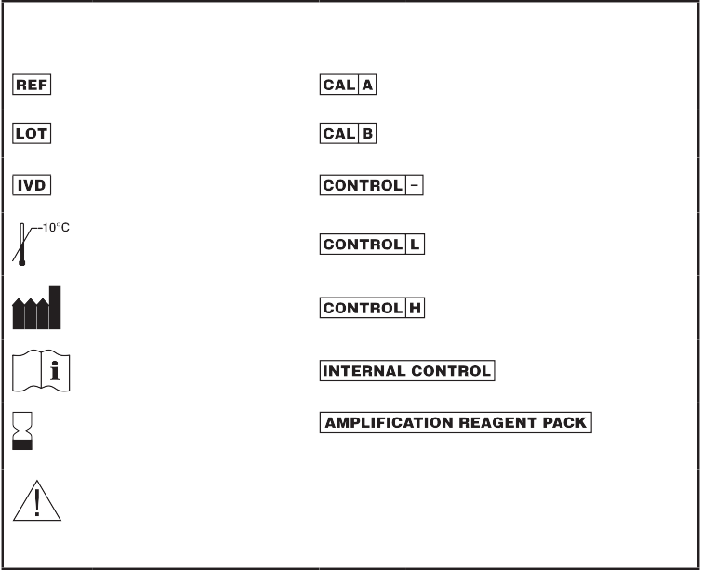
Abbott RealTime HCV
1N30-90
51-608374/R1
Rx Only
Abbott RealTime HCV
1N30
51-608374/R1
Customer Service: 1-800-553-7042
This package insert must be read carefully prior to use. Package insert instructions must be followed accordingly. Reliability of assay results cannot be guaranteed if there are any deviations from the instructions in this package insert.
Key to symbols used
therapy, and peginterferon plus ribavirin combination therapy.^{5–9} Current guidelines for the management and treatment of HCV recommend quantitative testing for HCV RNA before the start of antiviral therapy, during therapy, and after the conclusion of
treatment. The objective of treatment is a sustained virologic response (SVR), defined as the absence of HCV RNA detectable by a sensitive test 24 weeks after the end
of treatment.¹⁰ SVR is almost always preceded by an early virologic response (EVR), defined as a two-log or greater decrease in HCV viral load after 12 weeks of therapy. Failure to achieve EVR has a high negative predictive value for SVR.^{3,4}
A rapid viral response (RVR), undetectable levels of HCV RNA after 4 weeks of therapy, has a high positive predictive value for SVR.¹¹ Determinng viral kinetics during therapy has more recently been used to individualize treatment duration. Current guidelines¹⁰ recommend considering extended therapy for patients with genotype 1 infection who have delayed virus clearance (HCV viral load reaches undetectable levels between weeks 12 and 24).^{12–14}
HCV RNA in serum or plasma can be quantitated using nucleic acid amplification or signal amplification technologies.¹⁵ The Abbott RealTime HCV assay uses RT-
PCR technology combined with homogeneous real time fluorescent detection for the quantitation of HCV RNA. The selection of a conserved region of the HCV genome provides for the detection of genotypes 1, 2, 3, 4, 5, and 6. The assay is standardized against the Second WHO International Standard for Hepatitis C Virus RNA (NIBSC Code
96/798)¹⁶ and results are reported in International Units/mL (IU/mL).
BIOLOGICAL PRINCIPLES OF THE PROCEDURE
The Abbott RealTime HCV assay consists of three reagent kits:
Abbott RealTime HCV Amplification Reagent Kit
Abbott RealTime HCV Control Kit
Abbott RealTime HCV Calibrator Kit
The Abbott RealTime HCV assay uses RT-PCR¹⁷ to generate amplified product from the RNA genome of HCV in clinical specimens. In addition, an RNA sequence that is unrelated to the HCV target sequence is introduced into each specimen at the beginning of sample preparation. This unrelated RNA sequence is simultaneously amplified by RT-PCR and serves as an internal control (IC) to demonstrate that the process has proceeded correctly for each sample. The amount of target sequence
that is present at each amplification cycle is measured through the use of fluorescent labeled oligonucleotide probes on the Abbott m2000rt instrument. The probes do
not generate signal unless they are specifically bound to the amplified product. The amplification cycle at which the HCV-specific fluorescent signal is detected by the Abbott m2000rt is proportional to the log of the HCV RNA concentration present in the original sample.
Sample Preparation
The purpose of sample preparation is to extract and concentrate the target RNA molecules to make them accessible for amplification, and to remove potential inhibitors of amplification from the extract.
The Abbott m2000sp is an automated sample preparation system designed to use magnetic microparticle processes for the purification of nucleic acids from samples. The Abbott m2000sp instrument along with the Abbott mSample Preparation System (4 X 24 Preps) processes plasma or serum samples for nucleic acid amplification.
Multiple samples can be processed at once. The IC is taken through the entire sample preparation procedure along with the calibrators, controls, and specimens. After capture of nucleic acids onto magnetic microparticles, the microparticles are washed to remove unbound sample components. Next, the bound nucleic acids are eluted from the microparticles and the eluates are transferred to the Abbott 96 Deep-Well Plate.
Amplification Master Mix
The Abbott m2000sp instrument automates the assembly of the amplification master mix (HCV Oligonucleotide Reagent, Thermostable rTth Polymerase Enzyme, and Activation Reagent) and then transfers aliquots of the master mix to the Abbott 96-Well Optical Reaction Plate. Nucleic acid samples from the Abbott 96 Deep-Well Plate are then transferred into the Abbott 96-Well Optical Reaction Plate by the Abbott m2000sp. The plate is sealed by the user with an Abbott Optical Adhesive Cover and placed into the Abbott m2000rt instrument for PCR amplification and fluorescence detection.
Amplification
During the amplification reaction on the Abbott m2000rt, the target RNA is converted to cDNA by the reverse transcriptase activity of the thermostable rTth DNA polymerase. First, the HCV and IC reverse primers anneal to their respective targets and are extended during a prolonged incubation period. After a denaturation step, in which the temperature of the reaction is raised above the melting point of the double-stranded cDNA:RNA product, a second primer anneals to the cDNA strand and is extended
by the DNA polymerase activity of the rTth enzyme to create a double-stranded DNA product.
Reference Number
Calibrator A
Lot Number
In Vitro Diagnostic Medical Device
Calibrator B
Negative Control
Store at ≤ -10°C or colder
Low Positive Control
Manufacturer
High Positive Control
Consult instructions for use
Internal Control
Expiration Date
Amplification Reagent Pack
For Information Only - Not a Controlled Copy
CAUTION: Handle human sourced materials as potentially infectious. Consult instructions for use. (Infection Risk)
See REAGENTS section for a full explanation of symbols used in reagent component naming.
NAME
Abbott RealTime HCV
INTENDED USE
The Abbott RealTime HCV assay is an in vitro reverse transcription-polymerase chain reaction (RT-PCR) assay for use with the Abbott mSample Preparation System reagents and with the Abbott m2000sp and m2000rt instruments for the quantitation of hepatitis C viral (HCV) RNA in human serum or plasma (EDTA) from HCV-infected individuals.
Specimens containing HCV genotypes 1 – 6 have been validated for quantitation in the assay.
The Abbott RealTime HCV assay is intended for use as an aid in the management of HCV-infected patients undergoing antiviral therapy. The assay measures HCV RNA levels at baseline and during treatment and can be utilized to predict sustained and non-sustained virological response to HCV therapy. The results from the RealTime HCV assay must be interpreted within the context of all relevant clinical and laboratory findings.
Assay performance characteristics have been established for individuals treated with peginterferon alfa-2a or 2b plus ribavirin. No information is available on the assay’s predictive value when other therapies are used. Assay performance for determining the state of HCV infection has not been established.
The Abbott RealTime HCV assay is not for screening blood, plasma, serum or tissue donors for HCV, or to be used as a diagnostic test to confirm the presence of HCV infection.
SUMMARY AND EXPLANATION OF THE TEST
HCV is a single-stranded RNA virus, with a genome of 9,500 nucleotides.¹ HCV is a leading cause of liver disease in the United States, infecting an estimated 3.2 million people.² HCV has been transmitted primarily through intravenous drug use and through blood products. Sensitive serological tests for HCV antibodies have greatly reduced the incidence of new infections from donated blood. About 75 – 85% of HCV-infected individuals develop chronic hepatitis, with up to 20% of chronically infected individuals developing cirrhosis. In patients with cirrhosis, the incidence of hepatocellular carcinoma is 1 – 4% per year.^{3,4}
Quantitation of HCV RNA has been instrumental in understanding the effectiveness of antiviral response to interferon monotherapy, interferon plus ribavirin combination

Slide 2
During each round of thermal cycling, amplification products dissociate to single strands at high temperature allowing primer annealing and extension as the temperature is lowered. Exponential amplification of the product is achieved through repeated cycling between high and low temperatures, resulting in a billion-fold or greater amplification of target sequences. Amplification of both targets (HCV and IC) takes place simultaneously in the same reaction.
The target sequence for the Abbott RealTime HCV assay is in the 5´utr region of the HCV genome. This region is specific for HCV and is highly conserved.¹⁸ The primers are designed to hybridize to the 5´utr region with the fewest possible mismatches among HCV genotypes 1, 2, 3, 4, 5, and 6.
The IC target sequence is derived from the hydroxypyruvate reductase gene from the pumpkin plant, Cucurbita pepo and is delivered in an Armored RNA® particle that has been diluted in HCV-negative human plasma.
Detection
During the read cycles of amplification on the Abbott m2000rt, the temperature is lowered further to allow fluorescent detection of amplification products as the HCV and IC probes anneal to their targets (real-time fluorescence detection). The HCV and IC probes are single-stranded DNA oligonucleotides consisting of a probe sequence with a fluorescent moiety that is covalently linked to the 5´end of the probe and a quenching moiety that is covalently linked to the 3´ end of the probe.
In the absence of the HCV or IC target sequences, probe fluorescence is quenched.
In the presence of HCV or IC target sequences, probe hybridization to complementary sequences separates the fluorophore and the quencher and allows fluorescent emission and detection. The HCV and IC probes are each labeled with a different fluorophore, thus allowing for simultaneous detection of both amplified products at each cycle. The amplification cycle at which the HCV probe fluorescent signal is detected by the Abbott m2000rt is proportional to the log of the HCV RNA concentration present in the original sample.
Quantitation
A calibration curve is required to quantitate the HCV RNA concentration of specimens and controls. Two assay calibrators are run in replicates of three to generate a calibration curve. The calibration curve slope and intercept are calculated from the assigned HCV RNA concentration and the median observed threshold cycle for
each calibrator and are stored on the instrument. The concentration of HCV RNA in specimens and controls is calculated from the stored calibration curve, and the results are automatically reported on the Abbott m2000rt workstation. The Abbott RealTime HCV Negative Control, Low Positive Control, and High Positive Control must be included in each run to verify run validity. The Abbott m2000rt verifies that the controls are within the assigned ranges.
PREVENTION OF NUCLEIC ACID CONTAMINATION
The possibility of nucleic acid contamination is minimized because:
Reverse transcription, PCR amplification, and oligonucleotide hybridization occur in a sealed 96-Well Optical Reaction Plate.
Detection is carried out automatically without the need to open the 96-Well Optical Reaction Plate.
Aerosol barrier pipette tips are used for all pipetting. The pipette tips are discarded after use.
Separate dedicated areas are used to perform the Abbott RealTime HCV assay.
Refer to the SPECIAL PRECAUTIONS section of this package insert.
REAGENTS
Abbott RealTime HCV Amplification Reagent Kit (List No. 1N30-90)
tests for antibody to HCV, antibody to HIV-1, antibody to HIV-2, and HBsAg. The material is also tested and found to be negative by FDA licensed PCR methods for HIV-1 RNA and HCV RNA. Preservatives: 0.1% ProClin 300 and 0.15% ProClin 950.
3.
(8 vials, 1.3 mL per vial)
Abbott RealTime HCV High Positive Control (List No. 4J86X)
ǟ Noninfectious Armored RNA with HCV sequences in negative human plasma. Negative human plasma tested and found to be nonreactive by FDA licensed tests for antibody to HCV, antibody to HIV-1, antibody to HIV-2, and HBsAg. The material is also tested and found to be negative by FDA licensed PCR methods for HIV-1 RNA and HCV RNA. Preservatives: 0.1% ProClin 300 and 0.15% ProClin 950.
Abbott RealTime HCV Calibrator Kit (List No. 1N30-70)
1.
Abbott RealTime HCV Calibrator A (List No. 4J86A)
(12 vials, 1.3 mL per vial)
ǟ Noninfectious Armored RNA with HCV sequences in negative human plasma. Negative human plasma tested and found to be nonreactive by FDA licensed tests for antibody to HCV, antibody to HIV-1, antibody to HIV-2, and HBsAg. The material is also tested and found to be negative by FDA licensed PCR methods for HIV-1 RNA and HCV RNA. Preservatives: 0.1% ProClin 300 and 0.15% ProClin 950.
2.
Abbott RealTime HCV Calibrator B (List No.4J86B)
(12 vials, 1.3 mL per vial)
ǟ Noninfectious Armored RNA with HCV sequences in negative human plasma. Negative human plasma tested and found to be nonreactive by FDA licensed tests for antibody to HCV, antibody to HIV-1, antibody to HIV-2, and HBsAg. The material is also tested and found to be negative by FDA licensed PCR methods for HIV-1 RNA and HCV RNA. Preservatives: 0.1% ProClin 300 and 0.15% ProClin 950.
NOTE: Control and calibrator lots can be used interchangeably with amplification reagent kit lots. If a new amplification reagent kit lot is used, then a new calibration curve must be generated.
WARNINGS AND PRECAUTIONS
In Vitro Diagnostic Medical Device For In Vitro Diagnostic Use.
The Abbott RealTime HCV assay is not for screening blood, plasma, serum or tissue donors for HCV, or to be used as a diagnostic test to confirm the presence of HCV infection.
The Abbott RealTime HCV reagents are intended to be used only on the Abbott m2000 System consisting of the Abbott m2000sp for sample processing and the Abbott m2000rt for amplification and detection.
Only use Uracil-N-glycosylase (UNG) List No. 1N30-66 when performing the Uracil-N- Glycosylase protocol.
Do not use expired reagents.
NOTE: The Abbott m2000sp Master Mix Addition protocol must be initiated within 60 minutes after completion of Sample Preparation.
If the Abbott m2000sp master mix addition protocol is aborted, seal the Abbott 96-Well Optical Reaction Plate in a sealable plastic bag and dispose according to the Abbott m2000sp Operations Manual, Hazards section, along with the gloves used to handle the plate. Do not import the test order onto the Abbott m2000rt.
The appropriate PCR plate must be selected when samples are loaded into the Abbott
m2000rt instrument.
NOTE: The Abbott m2000rt protocol must be started within 50 minutes of the initiation of the Master Mix Addition protocol.
If the Abbott m2000rt instrument run is not initiated within 50 minutes, or is interrupted or aborted, seal the Abbott 96-Well Optical Reaction Plate in a sealable plastic bag and dispose according to the Abbott m2000rt Operations Manual along with the gloves used to handle the plate.
Safety Precautions
Refer to the Abbott m2000sp Operations Manual, Hazards Section and the Abbott
m2000rt Operations Manual, Hazards Section for instructions on safety precautions.
For Information Only - Not a Controlled Copy
1.
(4 vials, 1.2 mL per vial)
Abbott RealTime HCV Internal Control (List No. 4J86Y)
ǟ Less than 0.01% noninfectious Armored RNA with internal control sequences in negative human plasma. Negative human plasma tested and found to
be nonreactive by FDA licensed tests for antibody to HCV, antibody to HIV- 1, antibody to HIV-2, and HBsAg. The material is also tested and found to be negative by FDA licensed PCR methods for HIV-1 RNA and HCV RNA.
Preservatives: 0.1% ProClin® 300 and 0.15% ProClin 950.
2.
(List No. 1N30)
Abbott RealTime HCV Amplification Reagent Pack
Four packs of single-use reagents, 24 tests/pack. Discard after use. Each pack contains:
1 bottle (0.141 mL) Thermostable rTth Polymerase Enzyme (2.9 to 3.5 Units/µL) in buffered solution.
1 bottle (1.10 mL) HCV Oligonucleotide Reagent. Less than 0.1% synthetic oligonucleotides (4 primers and 2 probes) and less than 0.3% dNTPs in a buffered solution with a reference dye. Preservatives: 0.1% ProClin 300 and 0.15% ProClin 950.
1 bottle (0.40 mL) Activation Reagent. 30 mM manganese chloride solution.
Preservatives: 0.1% ProClin 300 and 0.15% ProClin 950.
CAUTION: The Calibrator Kit, Control Kit, and Internal Control contain human sourced and/or potentially infectious components. For a specific listing, refer to the REAGENTS section of this package insert. Components sourced from human blood have been tested and found to be nonreactive by FDA licensed tests for antibody to HCV, antibody to HIV-1, antibody to HIV-2, and HBsAg. The material is also tested and found to be negative by FDA licensed PCR methods for HIV-1 RNA and HCV RNA. No known test method can offer complete assurance that products derived from human sources or inactivated microorganisms will not transmit infection. These reagents and human specimens should be handled as if infectious, using safe laboratory procedures, such as those outlined in Biosafety in Microbiological and Biomedical Laboratories,¹⁹ OSHA Standard on Bloodborne Pathogens,²⁰ CLSI Document M29-A3,²² and other appropriate biosafety practices.^{21,22} Therefore, all human sourced materials should be considered potentially infectious.
These precautions include, but are not limited to, the following:
Wear gloves when handling specimens or reagents.
Do not pipette by mouth.
Do not eat, drink, smoke, apply cosmetics, or handle contact lenses in areas where these materials are handled.
Abbott RealTime HCV Control Kit (List No. 1N30-80)
1.
(8 vials, 1.8 mL per vial)
Abbott RealTime HCV Negative Control (List No. 4J86Z)
ǟ Negative human plasma tested and found to be nonreactive by FDA licensed tests for antibody to HCV, antibody to HIV-1, antibody to HIV-2, and HBsAg. The material is also tested and found to be negative by FDA licensed PCR methods for HIV-1 RNA and HCV RNA. Preservatives: 0.1% ProClin 300 and 0.15% ProClin 950.
2.
(8 vials, 1.3 mL per vial)
Abbott RealTime HCV Low Positive Control (List No. 4J86W)
ǟ Noninfectious Armored RNA with HCV sequences in negative human plasma. Negative human plasma tested and found to be nonreactive by FDA licensed

Slide 3
Clean and disinfect spills of specimens by using a tuberculocidal disinfectant such as 1.0% sodium hypochlorite or other suitable disinfectant.^{23,24}
Decontaminate and dispose of all specimens, reagents, and other potentially contaminated materials in accordance with local, state, and federal regulations.^{25,26}
The Abbott RealTime HCV Calibrator Kit, Control Kit, Internal Control, HCV Oligonucleotide Reagent, and Activation Reagent contain a mixture of 5-chloro-2- methyl-4-isothiazolin-3-one and 2-methyl-4-isothiazolin-3-one which are components of ProClin. The following are the appropriate Risk (R) and Safety (S) phrases:
Change gloves after having contact with potential contaminants (such as specimens, eluates, and/or amplified product).
To reduce the risk of nucleic acid contamination due to aerosols formed during pipetting, pipettes with aerosol barrier tips must be used for all sample and IC reagent pipetting. The length of the tip should be sufficient to prevent
contamination of the pipette barrel. While pipetting, care should be taken to avoid touching the pipette barrel to the inside surface of the sample tube or container. The use of extended aerosol barrier pipette tips is recommended.
Change aerosol barrier pipette tips between ALL manual liquid transfers.
Clean and disinfect spills of specimens and reagents as stated in the Abbott
m2000sp and the Abbott m2000rt Operations Manuals, Hazards section.
Replace any empty or partially used 200 JL and 1000 JL disposable tip trays with full trays before every run.
The Abbott mSample Preparation System reagents are single use only. Use new reagent vessels, reaction vessels, and newly opened reagents for every new Abbott RealTime HCV assay run. At the end of each run, discard all remaining reagents from the Abbott m2000sp worktable as stated in the Abbott m2000sp Operations Manual and the Abbott mSample Preparation System (4 X 24 Preps) product information sheet.
Contamination From External dU-Containing Amplified Product Laboratories that use or have used HCV amplification assays that include post-PCR processing of the amplified product may be contaminated by dU-containing amplified
product. Such contamination may cause inaccurate results in the Abbott RealTime HCV assay. Refer to the Monitoring the Laboratory for the Presence of Amplified Product section of this package insert.
When negative controls are persistently reactive or where contamination with dU containing HCV amplified product is likely to have occurred, it is recommended that the laboratory use the Uracil-N-Glycosylase (UNG) (List No. 01N30-66) contamination control procedure if decontamination of the laboratory is unsuccessful.
STORAGE INSTRUCTIONS
Abbott RealTime HCV Amplification Reagent Kit (List No. 1N30-90)
The Abbott RealTime HCV Amplification Reagent Pack and Internal Control vials must be stored at -10°C or colder when not in use. Care must be taken to separate the Abbott RealTime HCV Amplification Reagent Pack that is in use from direct contact with samples, calibrators and controls.
Abbott RealTime HCV Control Kit (List No. 1N30-80)
R43 May cause sensitization by skin contact. S24 Avoid contact with skin.
S35 This material and its container must be disposed of in a safe way. S37 Wear suitable gloves.
S46 If swallowed, seek medical advice immediately and show this container or label.
Special Precautions
Handling Precautions
The Abbott RealTime HCV assay is only for use with human serum and plasma (EDTA) specimens that have been handled and stored in capped tubes as described in the SPECIMEN COLLECTION, STORAGE, AND TRANSPORT TO THE TEST SITE section.
During preparation of samples, compliance with good laboratory practices is essential to minimize the risk of cross-contamination between samples, and the inadvertent introduction of ribonucleases (RNases) into samples during and after the extraction procedure. Proper aseptic technique should always be used when working with RNA.
Amplification reactions such as PCR are sensitive to accidental introduction of product from previous amplification reactions. Incorrect results could occur if either the clinical specimen or the RealTime reagents used in the amplification step become contaminated by accidental introduction of even a few molecules of amplification product. Measures to reduce the risk of contamination in the laboratory include
physically separating the activities involved in performing PCR and complying with good laboratory practices.
Work Areas
Use two dedicated areas within the laboratory for performing the Abbott RealTime HCV assay.
The Sample Preparation Area is dedicated to processing samples (specimens, Abbott RealTime HCV Controls, and Calibrators), and to adding processed samples, controls, and calibrators to the Abbott 96-Well Optical Reaction Plate. All reagents used in the Sample Preparation Area should remain in this dedicated area at all times. Laboratory coats, pipettes, pipette tips, and vortexers used in the Sample Preparation Area must remain in this area and not be moved to the Amplification Area. Do not bring amplification product into the Sample Preparation Area.
The Amplification Area is dedicated to the amplification and detection of amplified product. Laboratory coats and equipment used in the Amplification Area must remain in this area and not be moved to the Sample Preparation Area.
Components contained within a kit are intended to be used together. Do not mix components from different kit lots. For example, do not use the negative control from control kit lot X with the positive controls from control kit lot Y.
Do not use kits or reagents beyond expiration date.
Work areas and instrument platforms must be considered potential sources of contamination. Change gloves after contact with potential contaminants (such as specimens, eluates, and/or amplified product) before handling unopened reagents, negative control, positive controls, calibrators, or specimens. Refer to the Abbott m2000sp and m2000rt Operations Manuals for instructions on instrument cleaning procedures.
If the Abbott m2000sp instrument run is aborted, dispose of all commodities and reagents according to the Abbott m2000sp Operations Manual. If the Abbott m2000sp master mix addition protocol is aborted, seal the Abbott 96-Well Optical Reaction Plate in a sealable plastic bag and dispose according to the Abbott m2000sp Operations Manual, Hazards Section, along with the gloves used to handle the plate.
If the Abbott m2000rt instrument run is interrupted or aborted, seal the Abbott 96-Well Optical Reaction Plate in a sealable plastic bag and dispose according to the Abbott m2000rt Operations Manual along with the gloves used to handle the plate.
Decontaminate and dispose of all specimens, reagents, and other potentially biohazardous materials in accordance with local, state, and federal regulations.^{25,26} All materials should be handled in a manner that minimizes the chance of potential
contamination of the work area. Note: Autoclaving the sealed Abbott 96 well Optical Reaction Plate will not degrade the amplified product and may contribute to the release of the amplified product by opening the sealed plate. The laboratory area can become contaminated with amplified product if the waste materials are not carefully handled and contained before and after processing.
Aerosol Containment
To reduce the risk of nucleic acid contamination due to aerosols formed during manual pipetting, aerosol barrier pipette tips must be used for all manual pipetting. The pipette tips must be used only one time. Clean and disinfect spills of specimens and reagents as stated in the Abbott m2000sp and Abbott m2000rt Operations Manuals.
Contamination and Inhibition
The following precautions should be observed to minimize the risks of RNase contamination, cross-contamination between samples, and inhibition:
Wear appropriate personal protective equipment at all times.
Use powder-free gloves.
The Abbott RealTime HCV Negative and Positive Controls must be stored at
-10°C or colder.
For Information Only - Not a Controlled Copy
Abbott RealTime HCV Calibrator Kit (List No. 1N30-70)
The Abbott RealTime HCV Calibrator A and Calibrator B must be stored at
-10°C or colder.
SHIPPING CONDITIONS
Abbott RealTime HCV Amplification Reagent Kit: Ship on dry ice.
Abbott RealTime HCV Control Kit: Ship on dry ice.
Abbott RealTime HCV Calibrator Kit: Ship on dry ice.
If assay reagents, calibrators, or sample preparation reagents are received in a condition contrary to the label recommendation, or are damaged, contact Abbott Customer Service.
INDICATION OF INSTABILITY OR DETERIORATION OF REAGENTS
When a positive or negative control value is out of the expected range, it may indicate deterioration of the reagents. Associated test results are invalid and samples must
be retested. Assay recalibration may be necessary. Refer to the QUALITY CONTROL PROCEDURES: Assay Calibration section of this package insert for details.
SPECIMEN COLLECTION, STORAGE, AND TRANSPORT TO THE TEST SITE
Specimen Collection and Storage
Human serum and plasma (EDTA) specimens may be used with the Abbott RealTime HCV assay. Follow the manufacturer’s instructions for processing collection tubes.
Freshly drawn specimens (whole blood) may be held at 2 to 30°C for up to 6 hours prior to centrifugation.
After centrifugation, remove serum or plasma from cells. Serum or plasma specimens may be stored:
At 15 to 30°C for up to 24 hours
At 2 to 8°C for up to 3 days
At -10 to -30°C for up to 60 days
At -70°C or colder for up to 60 days
Exposure of plasma or serum samples to elevated room temperature for 24 hours or longer should be avoided. Multiple freeze/thaw cycles should be avoided and should not exceed three freeze/thaw cycles. If frozen, thaw specimens at 15 to 30°C or at 2 to 8°C. Once thawed, if specimens are not being processed immediately, they can be stored at 2 to 8°C for up to 6 hours.
Specimen Transport
Ship specimens frozen on dry ice. Specimens should be packaged and labeled in compliance with applicable state and federal regulations covering the transport of clinical specimens and etiologic agents/infectious substances.

Slide 4
INSTRUMENT PROCEDURE
The Abbott RealTime HCV application file(s) must be installed on the Abbott m2000sp and Abbott m2000rt instruments from the Abbott RealTime HCV m2000 System Combined Application CD-ROM prior to performing the assay. For detailed information on application file installation, refer to the Abbott m2000sp and m2000rt Operations Manuals, Operating Instructions section.
ABBOTT REALTIME HCV ASSAY PROCEDURE
Materials Provided
Abbott RealTime HCV Amplification Reagent Kit (List No. 1N30-90)
Materials Required But Not Provided
Abbott RealTime HCV Control Kit (List No. 1N30-80)
Abbott RealTime HCV Calibrator Kit (List No. 1N30-70)
Sample Preparation Area
Abbott m2000sp
Abbott mSample Preparation System (4 x 24 Preps) (List No. 4J70-24)
Abbott RealTime HCV m2000 System Combined Application CD-ROM (List No. 4N45)
Uracil-N-Glycosylase (UNG) (List No. 01N30-66) protocol*
5 mL Reaction Vessels ǟ 200 mL Reagent Vessels ǟ Master Mix Vial
Abbott 96-Well Optical Reaction Plate
Abbott 96-Deep Well Plate
Abbott Splash-Free Support Base
Abbott Optical Adhesive Cover
Abbott Adhesive Cover Applicator
Round-bottom 12.5 x 75 mm Sample Tubes
Vortex Mixer
Centrifuge capable of 2000g
Calibrated Precision Pipettes capable of delivering 10 µL-1000 µL ǟ 20 µL-1000 µL Aerosol Barrier Pipette Tips for precision pipettes ǟ Molecular Biology Grade Water (RNAse Free)**
1.7 mL Molecular Biology Grade Microcentrifuge Tubes (Dot Scientific, Inc. or equivalent)**
Cotton Tip Applicators (Puritan or Equivalent)**
Note: If required per the Contamination From External dU-Containing Amplified Product section of this package insert.
** Note: These items are used in the procedure for Monitoring the Laboratory for the Presence of Amplification Product. Refer to the QUALITY CONTROL PROCEDURES section of this package insert.
Amplification Area
Abbott m2000rt
Abbott RealTime HCV m2000 System Combined Application CD-ROM (List No. 4N45)
Abbott m2000rt Optical Calibration Kit (List No. 4J71-93)
Other Materials
Biological safety cabinet approved for working with infectious materials.
Sealable plastic bags
Procedural Precautions
Read the instructions in this package insert carefully before processing samples. The Abbott RealTime HCV Calibrators, Internal Control, Negative Control, and Positive Control vials are intended for single-use only and should be discarded after use.
Sample tubes should be inspected for air bubbles. If found, remove them with a sterile pipette tip. Caution should be taken to avoid cross-contamination between samples by using a new sterile pipette tip for each tube.
Reagent bubbles may interfere with proper detection of reagent levels in the reagent vessel, causing insufficient reagent aspiration, which could impact results.
NOTE: The Abbott m2000sp Master Mix Addition protocol must be initiated within one hour after completion of Sample Preparation.
If the Abbott m2000sp master mix addition protocol is not initiated, re-cap the Amplification Reagent vials and return the Amplification Reagent Pack to -10°C storage. The Abbott RealTime HCV Amplification Reagent Pack can be frozen and thawed a maximum of three additional times. If the Abbott m2000sp master mix addition protocol is aborted, then discard the amplification reagents.
NOTE: The m2000rt protocol must be started within 50 minutes of the initiation of the Master Mix Addition protocol.
If the Abbott m2000rt instrument run is not initiated within 50 minutes, or is interrupted or aborted, seal the Abbott 96-Well Optical Reaction Plate in a sealable plastic bag and dispose according to the Abbott m2000rt Operations Manual along with the gloves used to handle the plate.
Use aerosol barrier pipette tips or disposable pipettes only one time when pipetting specimens or Internal Control. To prevent contamination to the pipette barrel while pipetting, care should be taken to avoid touching the pipette barrel to the inside of the sample tube or container. The use of extended aerosol barrier pipette tips is recommended.
Monitoring procedures for the presence of amplification product can be found in the
QUALITY CONTROL PROCEDURES section in this package insert.
To reduce the risk of nucleic acid contamination, clean and disinfect spills of specimens by including the use of a tuberculocidal disinfectant such as 1.0% sodium hypochlorite or other suitable disinfectant.
The use of the Abbott RealTime HCV Controls and Calibrators is integral to the performance of the Abbott RealTime HCV assay. A calibration curve must be established before specimens are tested. Controls must be processed in conjunction with specimen testing. Refer to the QUALITY CONTROL PROCEDURES section of this package insert for details.
ASSAY PROTOCOL
Sample Preparation Area
All specimen storage and preparation must take place in the dedicated Sample Preparation Area. Refer to the Handling Precautions section of this package insert for instructions before preparing samples.
For a detailed description of how to operate the Abbott m2000sp instrument and Abbott m2000rt instrument, refer to the Abbott m2000sp and m2000rt Operations Manuals, Operating Instructions section.
Laboratory personnel must be trained to operate the Abbott m2000sp and m2000rt instruments. The operator must have a thorough knowledge of the applications run on the instruments and must follow good laboratory practices.
Sample Preparation Area
All specimen preparation must take place in the dedicated Sample Preparation Area. Refer to the Handling Precautions section of this package insert before preparing samples.
Thaw assay controls and Internal Control (IC) at 15 to 30°C or at 2 to 8°C. Thaw calibrators at 15 to 30°C or at 2 to 8°C only if performing a calibration run; see QUALITY CONTROL PROCEDURES section of this package insert.
Once thawed, if calibrators, controls, and IC are not being processed immediately, store at 2 to 8°C for up to 24 hours.
Vortex each assay calibrator and each control three times for 2 to 3 seconds before use. Ensure that bubbles or foaming are not created. If found, remove them with a new sterile pipette tip for each tube. Ensure that the contents of the vials are at the bottom after vortexing by tapping the vials on the bench to bring liquid to the bottom of the vial.
Thaw amplification reagents at 15 to 30°C or at 2 to 8°C and store at 2 to 8°C until required for the amplification master mix procedure. This step can be initiated before completion of the sample preparation procedure. Note: Do not vortex the Amplification Reagent Pack.
Once thawed store at 2 to 8°C for up to 24 hours if amplification reagents are not being processed immediately.
NOTE: Use one bottle of mLysis Buffer, one vial of IC, and one RealTime HCV Amplification Reagent Pack to support up to 24 reactions. Use a second set of reagents to support 25 to 48 reactions, three sets to support
49 to 72 reactions, and four sets to support up to 96 reactions. A maximum of 96 reactions can be performed per run.
Gently invert the Abbott mSample Preparation bottles to ensure a homogeneous solution. If crystals are observed in any of the reagent bottles upon opening, allow the reagent to equilibrate at room temperature until the crystals disappear. Do not use the reagents until the crystals have dissolved. Ensure bubbles or foam are not generated; if present, remove with a sterile pipette tip, using a new tip for each bottle.
Vortex each IC three times for 2 to 3 seconds before use. Ensure bubbles or foam are not generated; if present, remove with a sterile pipette tip, using a new tip for each vial.
Using a calibrated precision pipette DEDICATED FOR INTERNAL CONTROL USE ONLY, add 500 µL of IC to each bottle of mLysis Buffer. Mix by gently inverting the container 5 to 10 times to minimize foaming.
A total of 96 samples can be processed in each run. A negative control, a low positive control, and a high positive control must be included in each run, therefore allowing a maximum of 93 specimens to be processed per run.
The Abbott RealTime HCV assay general minimum sample volume requirements for the 13 mm and 16 mm sample tube racks are:
For Information Only - Not a Controlled Copy
Rack Tube Diameter* Minimum Sample Volume
13 mm
16 mm
11.5 mm – 14.0 mm
15.0 mm – 16.0 mm
0.9 mL
0.9 mL
* Refers to outer tube diameter and round bottom tubes. See the Standard Sample Racks, Tubes and Fill Volumes, Section 4 of the Abbott m2000sp Operations Manual for minimum volume by rack and tube type.
CAUTION: Do not put a 13 mm tube in a 16 mm rack.
If frozen, thaw specimens at 15 to 30°C or at 2 to 8°C. Once thawed, specimens can be stored at 2 to 8°C for up to 6 hours if not processed immediately.
Vortex each specimen three times for 2 to 3 seconds.
Centrifuge all serum specimens and any plasma specimens showing particulate matter or turbidity at 2,000g for 5 minutes before loading on the Abbott m2000sp worktable. Do not vortex after centrifugation.
Aliquot each specimen into clean tubes or vials if necessary. Refer to the Abbott m2000sp Operations Manual for tube sizes. Avoid touching the inside of the cap when opening tubes. Take care not to disturb contents of the tube while removing the tube from the centrifuge and that the bottom of the tube is not touched by the pipette tip. Ensure that the newly aliquotted sample retains the minimum volume indicated in the preceding table.
NOTE: The “g” refers to g force, not revolutions per minute (rpm).

Slide 5
Place the low and high positive controls, the negative control, the calibrators (if applicable), and the patient specimens into the Abbott m2000sp sample rack.
Place the 5 mL Reaction Vessels into the Abbott m2000sp 1 mL subsystem carrier.
Load the Abbott mSample Preparation System reagents and the Abbott 96 Deep- Well Plate on the Abbott m2000sp worktable as described in the Abbott m2000sp Operations Manual, Operating Instructions. _{Number of Samples}
Reagent 1 - 24 25 - 29 49 - 72 73 - 96
Place the sealed Abbott 96-Well Optical Reaction Plate into the Abbott Splash-Free Support Base for transfer to the m2000rt instrument.
Amplification Area
Place the Abbott 96-Well Optical Reaction Plate in the Abbott m2000rt instrument. From the Protocol screen, select the appropriate HCV application file. Initiate the Abbott RealTime HCV protocol, as described in the Abbott m2000rt Operations Manual, Operating Instructions section.
POST PROCESSING PROCEDURES
Remove the Abbott 96-Deep Well Plate from the worktable and dispose according to the Abbott m2000sp Operations Manual.
Place the Abbott 96-Well Optical Reaction Plate in a sealable plastic bag and dispose according to the Abbott m2000rt Operations Manual along with the gloves used to handle the plate.
Clean the Splash-Free Support Base before next use, according to the Abbott
m2000rt Operations Manual.
QUALITY CONTROL PROCEDURES
Abbott m2000rt Optical Calibration
Refer to the Calibration Procedures section in the Abbott m2000rt Operations Manual for a detailed description of how to perform an Abbott m2000rt Optical Calibration. Optical calibration of the Abbott m2000rt instrument is required for the accurate
measurement and discrimination of dye fluorescence during the Abbott RealTime HCV assay.
The following Abbott m2000rt Optical Calibration Plates are used to calibrate the Abbott
m2000rt instrument for the Abbott RealTime HCV assay:
FAM™ Plate (Carboxyfluorescein)
ROX™ Plate (Carboxy-X-rhodamine)
VIC® Plate (Proprietary dye)
Assay Calibration
For a detailed description of how to perform an Assay Calibration refer to the Operating Instructions section in the Abbott m2000sp and Abbott m2000rt Operations Manuals.
A calibration curve is required to quantitate HCV RNA concentration of specimens and controls. Two assay calibrators are run in replicates of three to generate a calibration
mMicroparticleª | 1 bottle | 2 bottles | 2 bottles | 2 bottles
mLysis^{b} (position 1) | 1 bottle | 2 bottles | 2 bottles | 2 bottles
mLysis^{b} (position 2) | Empty | Empty | 1 bottle | 2 bottles
mElution Buffer^{c} | 1 bottle | 2 bottles | 3 bottles | 4 bottles
mWash 1^{c} | 1 bottle | 2 bottles | 3 bottles | 4 bottles
mWash 2^{c} | 1 bottle | 2 bottles | 3 bottles | 4 bottles
ª The number of required mMicroparticle bottles never exceeds 2 bottles.
^{b} In applications where one or two bottles of mLysis are required, they should both be poured into the mLysis vessel in position 1. In applications where three or four bottles of mLysis are required, two should be poured into the mLysis vessel in position 1 and the remainder poured into the mLysis vessel in position 2. Each bottle of mLysis requires 500 µL IC.
^{c} As many as four bottles of reagents can be pooled into one vessel.
From the Run Sample Extraction screen, select the appropriate application file. Initiate the sample extraction protocol as described in the Abbott m2000sp Operations Manual, Operating Instruction.
Enter calibrator (needed if a calibration curve has not been stored on the Abbott m2000rt) and control lot specific values in the Sample Extraction: Assay Details screen. Lot specific values are specified in each Abbott RealTime HCV Calibrator and Control Kit card.
NOTE: Verify that the values entered match the values on the lot specific kit cards.
The Abbott m2000sp Master Mix Addition protocol (step 13) must be initiated within 60 minutes after completion of the Sample Preparation.
NOTE: Change gloves before handling the amplification reagents.
For those customers processing a batch size between 49 and 88 samples, prior to beginning the Abbott m2000sp Master Mix Addition protocol, fill the Abbott 96-Well Optical Reaction Plate columns as indicated in the table below with distilled or deionized water or mWash 2 buffer using the following instructions:
Place a new Abbott 96-Well Optical Reaction Plate in an Abbott Splash Free Support Base. NOTE: DO NOT touch the surface or bottom of the Abbott 96-Well Optical Reaction Plate.
Using a calibrated pipette, add 100 µL of distilled or deionized water or mWash 2 buffer to each well of the following Abbott 96-Well Optical Reaction Plate columns based on batch size:
Batch/Sample Size Complete Empty Column(s) to Fill with Water
curve (log HCV concentration versus the threshold cycle [C ] at which a reactive level
T
of fluorescent signal is detected). The lot specific values for Calibrator A and Calibrator
B are specified on each Abbott RealTime HCV Calibrator Kit Card and must be entered into the assay test order when a run is performed. The calibration curve slope and intercept are calculated and stored on the instrument. The concentration of HCV RNA in a sample is calculated from the stored calibration curve. Results are automatically reported on the Abbott m2000rt workstation.
For Information Only - Not a Controlled Copy
The Abbott RealTime HCV Low and High Positive Controls and Negative Control must be included in the calibration run.
Follow the procedure for sample extraction, mastermix addition, amplification and detection protocols as stated in the Abbott m2000sp Operations Manual and the Abbott m2000rt Operations Manual. Ensure that assay control values observed in the final report are within the ranges specified on the Abbott RealTime HCV Control Kit Card.
Once an Abbott RealTime HCV calibration is accepted and stored, it may be used for 6 months. During this time, all subsequent samples may be tested without further calibration unless:
An Abbott RealTime HCV Amplification Reagent Kit with a new lot number is used.
An Abbott mSample Preparation System (4 x 24 Preps) with a new lot number is used.
A new version of the Abbott RealTime HCV application specification file is installed.
An optical calibration of the Abbott m2000rt is performed per the Calibration Procedures section of the Abbott m2000rt Operations Manual.
Detection of Inhibition
49 – 56
57 – 64
65 – 72
73 – 80
81 – 88
89 – 96
through 12
through 12
through 12
and 12
12
NONE
NOTE: Be sure to read the column numbers on the top of the Abbott 96-Well Optical Reaction Plate to ensure correct column(s) are filled with water.
NOTE: Change gloves before handling the amplification reagents.
Load the amplification reagents, the master mix vial, and the Abbott 96-well Optical Reaction Plate on the Abbott m2000sp worktable after sample preparation is completed.
Each Amplification Reagent Pack supports up to 24 reactions.
Use a second Amplification Reagent Pack to support 25 to 48 reactions, a third to support 49 to 72 reactions, and a fourth to support up to 96 reactions. A maximum of 96 reactions can be performed per run.
Prior to opening the amplification reagents, ensure that the contents are at the bottom of the vials by tapping the vials in an upright position on the bench.
Remove the amplification vial caps.
Select the appropriate deep well plate from the Run Master Mix Addition screen that matches the corresponding sample preparation extraction. Initiate the Abbott m2000sp Master Mix Addition protocol. Follow the instructions as described in the Abbott m2000sp Operations Manual, Operating Instructions section.
The Abbott m2000rt protocol (step 17) must be started within 50 minutes of the initiation of the Master Mix Addition protocol (step 13).
Switch on and initialize the Abbott m2000rt in the amplification area.
The Abbott m2000rt requires 15 minutes to warm up.
NOTE: Change laboratory coats and gloves before returning to the sample preparation area.
Seal the Abbott 96-Well Optical Reaction Plate after the Abbott m2000sp
instrument has completed addition of samples and master mix according to the
An IC threshold cycle [C ] assay validity parameter is established during a calibration
run.
T
Prior to sample preparation, a defined, consistent quantity of IC is introduced into each specimen, calibrator, and control at the beginning of sample preparation and measured on the Abbott m2000rt instrument to demonstrate proper specimen processing and assay validity. The IC is comprised of a RNA sequence unrelated to the HCV target sequence.
The median amplification cycle at which the IC target sequence fluorescent signal is
detected in calibration samples establishes the IC C validity range to be met by all
T
subsequent processed specimens using that calibration curve.
An error control flag is displayed when a control result is out of range. Refer to the Abbott m2000rt Operations Manual for an explanation of the error code flag with suggested corrective actions. If negative or positive controls are out of range, all of the specimens and controls from that run must be reprocessed, beginning with sample preparation.
Negative and Positive Controls
An Abbott RealTime Negative Control, Low Positive Control, and High Positive Control are included in each run to evaluate run validity.
The lot specific values for the low positive control and high positive control are specified on each Abbott RealTime HCV Control Kit Card and must be entered into the Abbott m2000sp test order when a run is performed.
An error control flag is displayed when a control result is out of range. Refer to the Abbott m2000rt Operations Manual for an explanation of the error code flag with
Abbott m2000sp Operations Manual, Operating Instructions section.
suggestive corrective actions. If negative or positive controls are out of range, all of

Slide 6
the specimens and controls from that run must be reprocessed, beginning with sample preparation.
The presence of HCV must not be detected in the negative control. HCV detected in the negative control is indicative of contamination by other samples or by amplified product introduced during sample preparation or during preparation of the Abbott
96-Well Optical Reaction Plate. To avoid contamination, clean the Abbott m2000sp and Abbott m2000rt instruments and repeat the sample processing for controls and specimens following the Procedural Precautions. If negative controls are persistently reactive, contact your Area Customer Support representative.
Monitoring the Laboratory for the Presence of Amplification Product
It is recommended that this test be done at least once a month to monitor laboratory surfaces and equipment for contamination by amplification product. It is very important to test all areas that may have been exposed to processed specimens and controls, calibrators, and/or amplification product. This includes routinely handled objects such as pipettes, the Abbott m2000sp and Abbott m2000rt function keys, laboratory bench surfaces, microcentrifuges, and centrifuge adaptors.
Add 0.8 mL RNase-free water to a 1.7 mL RNase-free microcentrifuge tube for each laboratory surface to be monitored.
Saturate the cotton tip of an applicator (Puritan or equivalent) in the RNase-free water from the microcentrifuge tube.
Using the saturated cotton tip of the applicator, wipe the area to be monitored using a sweeping motion. Place the applicator back into the microcentrifuge tube from step 1.
Swirl the cotton tip in the RNase-free water 10 times, and then press the applicator along the inside of the microcentrifuge tube so that the liquid drains back into the solution at the bottom of the tube. Discard the applicator.
For each additional area to be monitored repeat steps 2 through 4.
Note: A small amount of mWash 1 buffer is added to each monitor sample in order to ensure that the ionic strength of the sample is sufficient for liquid level detection during processing on the m2000sp.
Pipette 0.5 mL of the mWash 1 buffer to a clean tube using the pipette dedicated for Internal Control use.
Add 20 µL of the mWash 1 buffer from step 6 to each microcentrifuge tube from step 4.
Cap the microcentrifuge tubes.
Transfer liquid from each microcentrifuge tube to unique 5 mL Reaction Vessels
Bring the volume in each 5 mL Reaction Vessel to 1.5 mL with RNase-free water
Place the 5 mL Reaction Vessels into the Abbott m2000sp sample rack and complete the assay following the ASSAY PROTOCOL section of this package insert. The Uracil-N-Glycosylase (UNG) (List No. 1N30-66) protocol should not be used to monitor the laboratory for presence of amplification product.
The presence of contamination is indicated by the detection of HCV nucleic acid in the swab samples.
If HCV nucleic acid is detected on equipment, follow the cleaning and decontaminating guidelines given in that equipment’s operations manual. If HCV nucleic acid is detected on surfaces, clean the contaminated areas with 1.0% (v/v) sodium hypochlorite solution, followed by 70% ethanol or water.
Note: Chlorine solutions may pit equipment and metal. Use sufficient amounts or repeated applications of 70% ethanol or water until chlorine residue is no longer visible.
Repeat testing of the contaminated area by following Steps 1 through 13.
RESULTS
Calculation
The concentration of viral HCV RNA in a sample or control is calculated from the stored calibration curve. The Abbott m2000rt instrument automatically reports the results on the Abbott m2000rt workstation. Assay results can be reported in IU/mL or Log IU/mL. Note: The assay is calibrated to the Second WHO International Standard for Hepatitis C Virus RNA.
INTERPRETATION OF RESULTS
The Abbott RealTime HCV assay results and interpretation will be reported as follows. An assay result unit of either Log IU/mL or IU/mL will be reported, selected as described in the Operating Instructions section of the m2000rt Operations Manual:
Result/Units
(consistent with the matrix of the original specimen), and the test repeated. Multiply the reported result by the dilution factor of 100 to obtain the quantitative result.
LIMITATIONS OF THE PROCEDURE
FOR IN VITRO DIAGNOSTIC USE.
Optimal performance of this test requires appropriate specimen collection, handling, preparation, storage and transport to the test site (refer to the SPECIMEN COLLECTION, STORAGE, AND TRANSPORT TO THE TEST SITE
section of this package insert).
Human serum and plasma specimens (EDTA) may be used with the Abbott RealTime HCV assay. The use of other anticoagulants has not been validated with the Abbott RealTime HCV assay.
Though rare, mutations within the highly conserved regions of the viral genome covered by the Abbott RealTime HCV assay primers and/or probe may result in the under-quantitation of or a failure to detect the presence of the virus in this circumstance.
Use of the Abbott RealTime HCV assay is limited to personnel who have been trained in the procedures of a molecular diagnostic assay and the Abbott m2000sp and m2000rt instruments.
The instruments and assay procedures reduce the risk of contamination by amplification product. However, nucleic acid contamination from the calibrators, positive controls, or specimens must be controlled by good laboratory practice and careful adherence to the procedures specified in this package insert.
A specimen with a result of “Not Detected” cannot be presumed to be negative for HCV RNA.
Precision was established with HCV Genotypes 1 and 3 only.
Some of the cross-reactivity studies were performed with nucleic acids (DNA and RNA) only. For further detail, refer to the SPECIFIC PERFORMANCE CHARACTERISTICS section of this package insert.
As with any diagnostic test, results from the Abbott RealTime HCV assay should be interpreted in conjunction with other clinical and laboratory findings.
Due to inherent differences between technologies, it is recommended that, prior to switching from one technology to the next, users perform method correlation studies in their laboratory to quantify technology differences.
Contamination from HCV positive controls and clinical specimens can be avoided only by good laboratory practices and careful adherence to the procedures specified in this package insert.
SPECIFIC PERFORMANCE CHARACTERISTICS
WHO Standardization
The Abbott RealTime HCV assay is standardized to the Second WHO International Standard for Hepatitis C Virus RNA (NIBSC Code 96/798).¹⁶ The Abbott RealTime HCV assay uses two calibrators targeted to 3.00 and 7.00 log IU/mL. Primary Calibrators are assigned lot-specific HCV RNA concentrations based on the results of direct testing against the WHO IS. Product Calibrators are, in turn, assigned lot-specific HCV RNA concentrations based on the results of direct testing against Primary Calibrators. The lot-specific quantitation values for each HCV Calibrator, Primary or Product, are entered into the m2000rt software when a calibration run is performed.
Standardization to the WHO IS was demonstrated by comparison of observed HCV RNA concentrations of dilutions of the WHO IS to expected concentrations based on the WHO IS assigned value of 5.00 log IU/mL. Three comparisons are shown in Figure
1. In each comparison, observed HCV RNA concentrations of dilutions of the WHO IS are plotted as a function of the expected concentration. The observed concentrations of the calibrators used for each WHO IS comparison are also plotted against the expected concentrations of the calibrators. Expected concentrations for the calibrators are the lot-specific values. For calibrators, the observed concentrations are equal to the expected concentrations.
In the first comparison, dilutions of the WHO IS, reconstituted per instructions and diluted 1:2 and 1:20 with negative human plasma to expected concentrations of
4.70 and 3.70 log IU/mL, were quantitated by Primary Calibrators. In two additional comparisons, WHO IS dilutions from 1.00 to 1.40 log IU/mL (10 to 25 IU/mL), prepared for LoD studies, were quantitated by two separate lots of Product Calibrators.
The mean difference between observed and expected concentration for each dilution of the WHO IS ranged from -0.17 to 0.03 log IU/mL. These results demonstrate that the Abbott RealTime HCV assay, using either Primary Calibrators or Product Calibrators, returns quantitation values for the WHO International Standard in good agreement with expected values in a range from half the concentration of the undiluted standard to the lower limit of quantitation (LLQ) of the assay, as shown in Figure 1.
For Information Only - Not a Controlled Copy
Log IU/mL | IU/mL | Interpretation
Not Detected | Not Detected | Target not detected
< 1.08 Log IU/mL 1.08 to 8.00 Log IU/mL^{b} > 8.00 Log IU/mL^{c} | < 12 IU/mL 12 to 100,000,000 IU/mL^{b} > 100,000,000 IU/mL^{c} | Detectedª > ULQ
ª Below LLQ (lower limit of quantitation or LLoQ); HCV RNA can be detected but is not quantifiable.
^{b} A result between 1.08 and 8.00 Log IU/mL mL (12 to 100,000,000 IU/mL) indicates that HCV RNA was detected and the concentration falls between the LLQ and ULQ.
^{c} A result of “>8.00 Log IU/mL” (“> 100,000,000 IU/mL”) indicates that target was detected and is greater than ULQ (upper limit of quantitation).
NOTE: Review any flags applied to a result. Refer to the Abbott m2000sp or Abbott m2000rt Operations Manuals.
If negative or positive controls are out of range, all of the specimens and controls from that run must be reprocessed, beginning with sample preparation.
If quantitative results are desired for those specimens with interpretation “> ULQ”
the original specimen should be diluted 1:100 with HCV-negative plasma or serum

Slide 7
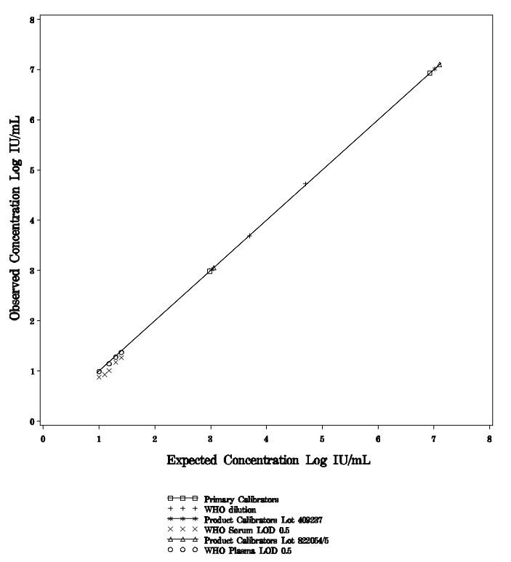
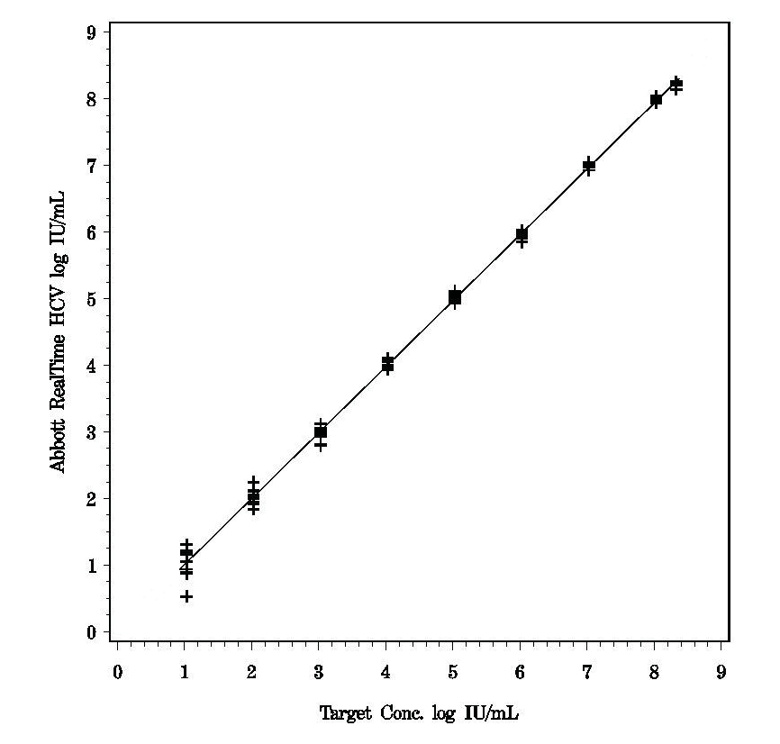
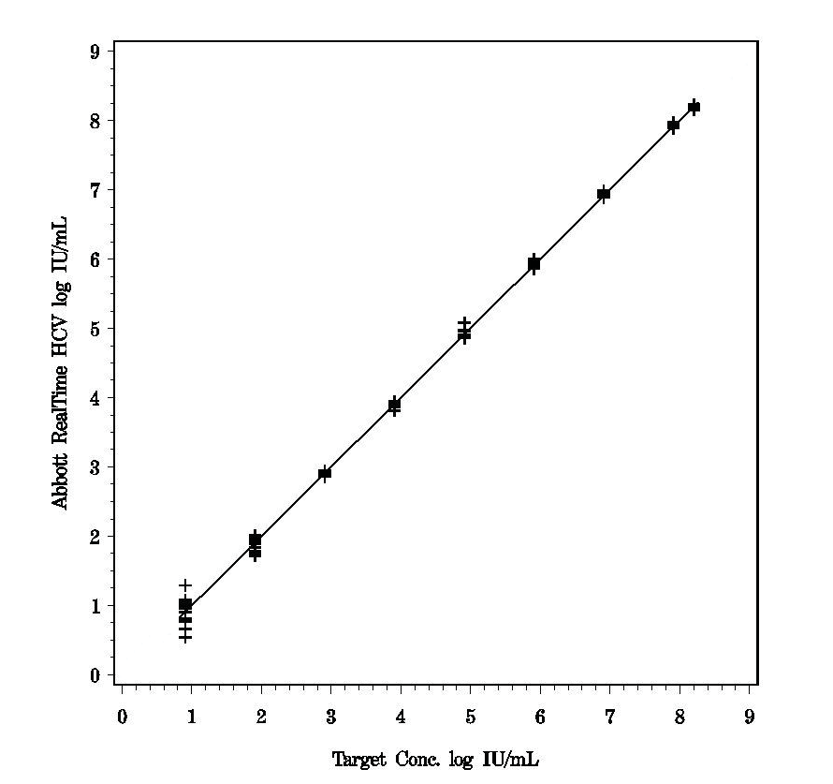
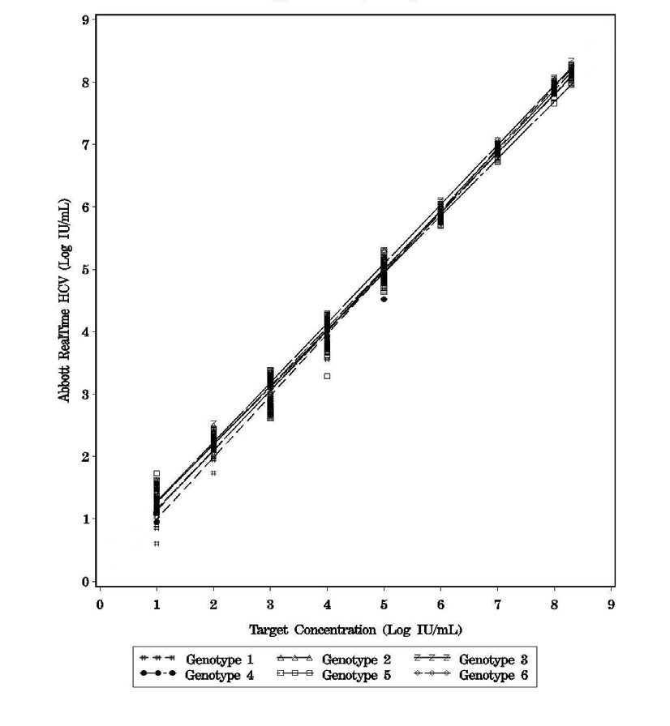
Figure 1 Abbott RealTime HCV
Standardization to WHO IS
The results, representative of the RealTime HCV assay linearity in serum, are shown in Figure 3.
Figure 3 Abbott RealTime HCV Linearity with Serum
y = 0.99x + 0.01 r = 0.999
n = 106
Linear Range
The upper limit of quantitation (ULQ) for the Abbott RealTime HCV assay is 100,000,000 IU/mL (8.00 log IU/mL) and the lower limit of quantitation (LLQ) is equivalent to LoD (12 IU/mL or 1.08 log IU/mL).
The linearity analysis was performed according to CLSI Guideline EP6-A “Evaluation of the Linearity of Quantitative Measurement Procedures: A Statistical Approach; Approved Guideline.” ²⁷ A 9-member panel prepared by diluting HCV armored RNA (genotype 1) from 8.21 log IU/mL to 0.91 log IU/mL in HCV negative human plasma was tested. Data from this study demonstrated that the RealTime HCV assay is capable of quantitating HCV across the linear range with a deviation of not more than 0.08 log IU/mL.
The results, representative of the Abbott RealTime HCV assay linearity in plasma, are shown in Figure 2.
Figure 2 Abbott RealTime HCV Linearity with Plasma
The Abbott RealTime HCV assay was shown to be linear in serum and plasma across the range of HCV RNA concentrations tested.
Linearity by Genotype
The linear range was evaluated per the recommendations in the CLSI Guideline EP6A, “Evaluation of the Linearity of Quantitative Measurement Procedures: A Statistical Approach; Approved Guideline.” ²⁷
The linearity of the RealTime HCV assay was demonstrated by evaluating a dilution series for each HCV genotype 1 through 6 with concentrations ranging from 1.00 log IU/mL to 8.30 log IU/mL. Two linearity panels were used to evaluate the linear range. These panels consisted of dilutions in plasma of a high titer HCV RNA positive clinical specimen for the lower and middle part of the dynamic range and, due to unavailability of very high titer clinical material, of Armored HCV RNA for the high end of the dynamic range. The panel members were tested in replicates of 12. The study was performed using two lots of the Abbott RealTime HCV reagents.
The result of these analyses demonstrated that the RealTime HCV assay is capable of quantitating different HCV genotypes across the linear range with deviation of not more than 0.28 log IU/mL. The results are summarized in Figure 4 and Table 1.
For Information Only - Not a Controlled Copy
y = 1.00x - 0.01 r = 0.999
n = 106
Figure 4 Abbott RealTime HCV Linearity By Genotype
A 9-member panel prepared by diluting HCV armored RNA from 8.33 log IU/mL to 1.03 log IU/mL in HCV negative human serum was tested. Data from this study demonstrated that the RealTime HCV assay is capable of quantitating HCV across the linear range
with a deviation of not more than 0.10 log IU/mL.

Slide 8
Table 1 Abbott RealTime HCV
Linearity of Assay by HCV Genotypes
Genotype | Linear Equation from Linearity Study | Maximum Difference Between Genotype 1 and Corresponding Genotype (Log IU/mL)ª
1 | Y = 0.99X + 0.01 | NA
2 | Y = 0.93X + 0.33 | 0.26
3 | Y = 0.95X + 0.33 | 0.28
4 | Y = 0.95X + 0.20 | 0.15
5 | Y = 0.92X + 0.37 | 0.28
6 | Y = 0.96X + 0.17 | 0.13
ª The maximum difference was obtained at the assay ULQ (ULoQ) or LLQ (LLoQ).
Limit of Quantitation (LOQ)
The total analytical error (TAE) was calculated using estimates determined through analysis of data from limit of detection (LoD) studies (Genotype 1) and internal precision and external reproducibility studies
(Genotypes 1 and 3).
The TAE estimates for plasma panel members that had an observed concentration at or near the assay limit of detection (12 IU/mL or 1.08 log IU/mL) are presented in Table 2. The TAE estimates for serum panel members that had an observed concentration at or near the assay limit of detection are presented in Table 3. TAE was estimated by two different methods (see table footnotes).
The results of these analyses demonstrated that the Abbott RealTime HCV assay can determine with an acceptable level of accuracy the concentration of HCV RNA in plasma (EDTA) and serum at a concentration of 12 IU/mL
(1.08 log IU/mL). At this concentration, the difference between two measurements of more than 1.00 log IU/mL is statistically significant.
Table 2 Abbott RealTime HCV
Total Analytical Error (TAE) Estimates (Plasma) (Log IU/mL)
Plasma
Concentration
Total
TAE^{c}
Absolute Bias
TAE^{d} SQRT(2)
Panel Member Genotype |  | n | Expected | Observed | Bias | SD | + (2 x SD) | x (2 x SD)
Internal Precision Study 1 3 |  | 65 | 1.00 | 0.88ª | -0.12 | 0.25^{b} | 0.62 | 0.71
Internal LOD Study
4 | 1 | 56 | 1.00 | 0.99ª | -0.01 | 0.26 | 0.53 | 0.74
5 | 1 | 53 | 1.10 | 1.11 | 0.02 | 0.25 | 0.51 | 0.69
6 | 1 | 55 | 1.18 | 1.14 | -0.03 | 0.25 | 0.52 | 0.69
External Reproducibility Study
4 | 1 | 269 | 1.23 | 1.07ª | -0.16 | 0.21^{b} | 0.58 | 0.59
5 | 1 | 242 | 0.68 | 0.61ª | -0.07 | 0.25^{b} | 0.57 | 0.71
9 | 3 | 270 | 1.34 | 1.34 | 0.00 | 0.17^{b} | 0.34 | 0.48
10 | 3 | 252 | 0.76 | 0.73ª | -0.03 | 0.30^{b} | 0.63 | 0.84
For Information Only - Not a Controlled Copy
ª Panel member is below the LoD (1.08 log IU/mL).
^{b} Total SD = Within-run component variability + Between-run component variability.
^{c} Per section 5.1 of EP17-A CLSI guideline.²⁸
^{d} Based upon the difference between two measurements approach.
Table 3 Abbott RealTime HCV
Total Analytical Error (TAE) Estimates (Serum) (Log IU/mL)
Concentration
TAE^{b}
TAE^{c}
Serum Panel Member | Genotype | n | Expected | Observed | Bias | Total SD | Absolute Bias + (2 x SD) | SQRT(2) x (2 x SD)
Internal LOD Study
4 | 1 | 58 | 1.00 | 0.87ª | -0.13 | 0.21 | 0.55 | 0.59
5 | 1 | 60 | 1.10 | 0.93ª | -0.17 | 0.22 | 0.61 | 0.63
6 | 1 | 60 | 1.18 | 1.01ª | -0.17 | 0.19 | 0.55 | 0.54
ª Panel member is below the LoD (1.08 log IU/mL).
^{b} Per section 5.1 of EP17-A CLSI guideline.²⁸
^{c} Based upon the difference between two measurements approach.

Slide 9
Limit of Quantitation: Genotype
The total analytical error (TAE) was calculated using estimates determined through analysis of data from the genotype limit of detection (LoD) study. HCV Genotypes 1 through 6 were tested in plasma. For each genotype, panel members were targeted to concentrations of 1.00, 1.10, and 1.18 log IU/mL (10.0, 12.5 and 15.0 IU/mL). The results are summarized in Table 4.
The results of these analyses demonstrated that, for samples of HCV genotypes 1 through 6, the Abbott RealTime HCV assay can determine with an acceptable level of accuracy the concentration of HCV RNA in plasma (EDTA) and serum at a concentration of 12 IU/mL (1.08 log IU/mL). At this concentration, the difference between two measurements of more than 1.00 log IU/mL is statistically significant.
Table 4 Abbott RealTime HCV
Total Analytical Error (TAE) Estimates by Genotype (Log IU/mL)
Table 4
Abbott RealTime HCV Genotype
Total Analytical Error (TAE) Estimates by Genotype (Log IU/mL)
Genotype /
Concentration
TAE^{b}
Absolute
TAE^{c}
Genotype /
Concentration
TAE^{b}
Absolute
TAE^{c}
LOD Panel Member | n | Expected | Observed | Bias | Total SD | Bias + (2 x SD) | SQRT(2) x (2 x SD) |  | LOD Panel Member | n | Expected | Observed | Bias | Total SD | Bias + (2 x SD) | SQRT(2) x (2 x SD)
Genotype 1 |  |  |  |  |  |  |  |  | Genotype 4
4 | 28 | 1.00 | 0.94ª | -0.06 | 0.30 | 0.66 | 0.85 |  | 4 | 27 | 1.00 | 0.87ª | -0.13 | 0.25 | 0.63 | 0.72
5 | 30 | 1.10 | 0.95ª | -0.15 | 0.31 | 0.77 | 0.88 |  | 5 | 30 | 1.10 | 1.04ª | -0.05 | 0.16 | 0.37 | 0.45
6 | 30 | 1.18 | 1.12 | -0.06 | 0.20 | 0.45 | 0.56 |  | 6 | 30 | 1.18 | 1.19 | 0.01 | 0.20 | 0.41 | 0.56
Genotype 2 |  |  |  |  |  |  |  |  | Genotype 5
4 | 29 | 1.00 | 0.97ª | -0.03 | 0.28 | 0.59 | 0.79 |  | 4 | 30 | 1.00 | 0.96ª | -0.04 | 0.24 | 0.53 | 0.69
5 | 30 | 1.10 | 1.10 | 0.00 | 0.21 | 0.43 | 0.61 |  | 5 | 30 | 1.10 | 1.11 | 0.01 | 0.20 | 0.41 | 0.56
6 | 30 | 1.18 | 1.19 | 0.02 | 0.25 | 0.51 | 0.70 |  | 6 | 30 | 1.18 | 1.19 | 0.01 | 0.31 | 0.63 | 0.87
Genotype 3 |  |  |  |  |  |  |  |  | Genotype 6
4 | 29 | 1.00 | 0.99ª | -0.01 | 0.23 | 0.47 | 0.64 |  | 4 | 30 | 1.00 | 1.08 | 0.08 | 0.23 | 0.54 | 0.64
5 | 30 | 1.10 | 1.12 | 0.02 | 0.20 | 0.42 | 0.56 |  | 5 | 30 | 1.10 | 1.15 | 0.05 | 0.23 | 0.52 | 0.66
6 | 30 | 1.18 | 1.26 | 0.08 | 0.16 | 0.40 | 0.46 |  | 6 | 30 | 1.18 | 1.23 | 0.06 | 0.22 | 0.49 | 0.61
ª Panel member is below the LoD (1.08 log IU/mL).
^{b} Per section 5.1 of EP17-A CLSI guideline.²⁸
^{c} Based upon the difference between two measurements approach.
ª Panel member is below the LoD (1.08 log IU/mL).
^{b} Per section 5.1 of EP17-A CLSI guideline.²⁸
^{c} Based upon the difference between two measurements approach.
For Information Only - Not a Controlled Copy
WITHIN-LABORATORY PRECISION: LOT-TO-LOT
The precision of the Abbott RealTime HCV assay was evaluated using an 8-member HCV RNA panel. Panel members 1 through 5 were dilutions of an HCV genotype 3 clinical sample. Panel members 1, 3, and 5 were diluted in HCV negative human plasma and panel members 2 and 4 were diluted in HCV negative human serum. Panel members 6 through 8 were prepared by diluting HCV armored RNA in HCV negative human plasma. Three Abbott m2000 Instrument Systems were used with a unique lot of amplification reagents assigned to each. One run per day was performed on each instrument pair for five days for a total of 15 runs. Panel members 1 through 8 were run in replicates of four in
the first run on each instrument pair and replicates of five in each subsequent run for a total of 72 replicates across the three Abbott m2000 Instrument Systems. Within-run, between-run, between lot/instrument, and total standard deviations for log IU/mL and %CV for IU/mL were determined. The total SD for the Abbott RealTime HCV assay was found to be less than or equal to 0.10 log IU/mL for all panel members that exceeded the assay limit of detection (12 IU/mL or 1.08 log IU/mL). The results, representative of the precision of the Abbott RealTime HCV assay, are summarized in Table 5 and Table 6.
Table 5 Abbott RealTime HCV
Within-Laboratory Precision Analysis: Lot-to-Lot (Log IU/mL)
Panel | Genotype | n | Mean Concentration (Log IU/mL) | Within-Run Component SDª | Between-Run Component SDª | Between- Lot/Instrument Component SDª | Total SD^{a,b}
1 | 3 | 65^{c} | 0.88 | 0.25 | 0.00 | 0.13 | 0.28
2 | 3 | 72 | 1.96 | 0.08 | 0.04 | 0.04 | 0.10
3 | 3 | 72 | 2.75 | 0.05 | 0.03 | 0.04 | 0.08
4 | 3 | 72 | 3.95 | 0.03 | 0.02 | 0.03 | 0.05
5 | 3 | 71^{d} | 4.79 | 0.04 | 0.02 | 0.04 | 0.06
6 | 1 | 71^{d} | 5.97 | 0.04 | 0.02 | 0.02 | 0.05
7 | 1 | 71^{d} | 7.00 | 0.07 | 0.01 | 0.02 | 0.08
8 | 1 | 71^{d} | 8.04 | 0.04 | 0.01 | 0.05 | 0.06
ª Standard Deviations (SD) are in log IU/mL.
^{b} Includes Within-Run, Between-Run, and Between-Lot/Instrument components.
^{c} HCV RNA was not detected in seven replicates. This level is below the LoD (1.08 log IU/mL).
^{d} One replicate was not available for the data analysis due to an instrument error.

Slide 10
Table 6 Abbott RealTime HCV
Within-Laboratory Precision Analysis: Lot-to-Lot (IU/mL)
Panel Member | Genotype | n | Mean Concentration (IU/mL) | Within-Run Component %CV | Between-Run Component %CV | Between- Lot/Instrument Component %CV | Total %CVª
1 | 3 | 65^{b} | 9 | 53.8 | 0.0 | 22.6 | 58.4
2 | 3 | 72 | 94 | 18.5 | 9.6 | 10.7 | 23.4
3 | 3 | 72 | 572 | 12.5 | 7.1 | 9.0 | 17.0
4 | 3 | 72 | 8,901 | 6.5 | 5.5 | 7.5 | 11.4
5 | 3 | 71^{c} | 61,792 | 8.8 | 5.2 | 8.8 | 13.5
6 | 1 | 71^{c} | 930,544 | 8.4 | 5.7 | 4.6 | 11.2
7 | 1 | 71^{c} | 10,199,543 | 16.5 | 0.0 | 7.2 | 17.9
8 | 1 | 71^{c} | 110,214,079 | 8.5 | 3.3 | 11.7 | 14.9
ª Includes Within-Run, Between-Run, and Between-Lot/Instrument components.
^{b} HCV RNA was not detected in seven replicates. This level is below the LoD (12 IU/mL).
^{c} One replicate was not available for the data analysis due to an instrument error.
WITHIN-LABORATORY PRECISION: OPERATOR-TO-OPERATOR
The within-run, between-run, and between-technician (operator) precision of the Abbott RealTime HCV Assay was evaluated by testing 84 replicates each of HCV panel members that span the dynamic range of the assay from approximately 1.08 log IU/mL to approximately 8.0 log IU/mL for HCV Genotypes 1 and 3. Panel members 1 through 5 were HCV Genotype 1, and panel members 6 through 10 were HCV Genotype 3. One lot of amplification reagents was run on one m2000sp and m2000rt instrument pair by three technicians. Each technician completed one run per day for seven days, for a total of 21 runs. Four replicates were run for each panel member.
The SD for between-technician component and total SD for the Abbott RealTime HCV assay was found to be less than or equal to 0.02
log IU/mL and 0.23 log IU/mL, respectively, for all panel members that exceeded the assay limit of detection (1.08 log IU/mL). The results are summarized in Table 7.
Table 7 Abbott RealTime HCV
Within-Laboratory Precision Analysis: Operator-to-Operator (Log IU/mL)
For Information Only - Not a Controlled Copy
Panel Member | Genotype | n | Mean Concentration (Log IU/mL) | Within-Run Component _{SD}a,b | Between-Run Component _{SD}a,c | Between- Technician Component _{SD}a,d | Total SD^{a,e}
1 | 1a | 84 | 7.94 | 0.05 | 0.02 | 0.00 | 0.05
2 | 1a | 84 | 5.09 | 0.08 | 0.02 | 0.00 | 0.08
3 | 1a | 84 | 3.16 | 0.07 | 0.03 | 0.01 | 0.08
4 | 1a | 84 | 1.09 | 0.23 | 0.00 | 0.00 | 0.23
5 | 1a | 76^{f} | 0.59 | 0.23 | 0.03 | 0.00 | 0.24
6 | 3 | 84 | 6.89 | 0.07 | 0.00 | 0.00 | 0.07
7 | 3a | 84 | 4.43 | 0.09 | 0.01 | 0.00 | 0.09
8 | 3a | 84 | 2.60 | 0.10 | 0.02 | 0.02 | 0.10
9 | 3a | 82^{g} | 1.29 | 0.17 | 0.04 | 0.00 | 0.17
10 | 3a | 70^{h} | 0.70 | 0.19 | 0.03 | 0.00 | 0.20
ª Standard Deviations (SD) are in log IU/mL.
^{b} Within-Run Component = Intra-Run component.
^{c} Between-Run Component = Inter-Run component.
^{d} Between-Technician component = Inter-Operator component.
^{e} Total SD = Intra-Run component + Inter-Run component + Inter-Operator component.
^{f} One replicate was not included due to an instrument error. Seven replicates generated a result of “Target Not Detected” and were not included in the analysis. This level is below the LoD (1.08 log IU/mL).
^{g} Two replicates were not included due to an instrument error.
^{h} Fourteen replicates generated a result of “Target Not Detected” and were not included in the analysis. This level is below the LoD (1.08 log IU/mL).

Slide 11
REPRODUCIBILITY
The Reproducibility panel tested consisted of a 90-member panel (consisting of 10 unique panel members). The HCV genotypes selected for the Reproducibility panel were genotypes that were recognized as prevalent in the U.S. population. The panel included five concentration levels of each of two HCV genotypes with each level represented nine times. All panel members were diluted in a base matrix of defibrinated human plasma. Panel member 1 consisted of HCV Genotype 1a armored RNA. Panel members 2, 3, 4, and 5 were prepared from a mix of two unique donor units of HCV Genotype 1a. Panel member 6 consisted of HCV Genotype 3 armored RNA. Panel members 7, 8, 9, and 10 were prepared from a mix of two unique donor units of HCV Genotype 3a.
The concentration levels targeted for the Reproducibility panel spanned the linear quantitation range of the assay and also included some members below the lower limit of quantitation. A total of three Abbott RealTime HCV Amplification reagent lots were used. Each of the three clinical sites tested two of the three Amplification reagent lots for five nonconsecutive days each, resulting in a total of 10 reproducibility runs at each site.
The Reproducibility results are summarized in Tables 8 and 9.
Table 8
Abbott RealTime HCV Clinical Reproducibility (Log IU/mL)
Panel
Member Genotype n
Mean
Concentration Within-Run Between-Run Between-Lot Between-Site
(Log IU/mL) Component SDª Component SDª Component SDª Component SDª Total SD^{a,b}
1 | 1a | 270 | 7.98 | 0.04 | 0.00 | 0.02 | 0.08 | 0.09
2 | 1a | 269^{c} | 5.15 | 0.05 | 0.03 | 0.00 | 0.05 | 0.08
3 | 1a | 270 | 3.17 | 0.07 | 0.02 | 0.00 | 0.02 | 0.08
4 | 1a | 269^{d} | 1.07^{j} | 0.21 | 0.00 | 0.03 | 0.04 | 0.22
5 | 1a | 242e | 0.61^{j} | 0.25 | 0.03 | 0.05 | 0.07 | 0.27
6 | 3 | 266^{f} | 6.96 | 0.06 | 0.02 | 0.02 | 0.06 | 0.09
7 | 3a | 270 | 4.51 | 0.06 | 0.03 | 0.01 | 0.04 | 0.08
8 | 3a | 270 | 2.61 | 0.07 | 0.02 | 0.01 | 0.03 | 0.08
9 | 3a | 270^{g} | 1.34 | 0.17 | 0.00 | 0.04 | 0.07 | 0.19
10 | 3a | ₂₅₂c,h,i | 0.73^{j} | 0.29 | 0.05 | 0.08 | 0.00 | 0.31
ª Standard deviations are in log IU/mL.
^{b} The total variability contains within-run, between-run, between-lot, and between-site variability.
^{c} One invalid replicate not included.
^{d} Target not detected for one sample of panel 4.
^{e} Target not detected for twenty-eight samples of panel 5.
^{f} Four invalid replicates not included.
^{g} One replicate was an outlier. Without this replicate, the Panel 9 mean concentration was 1.34 log IU/mL, within-run component SD was 0.15, the between-run component SD was 0.00, the between-lot component SD was 0.04, the between-site SD was 0.06, and the total SD was 0.17.
^{h} Target not detected for seventeen samples of Panel 10.
^{i} Two replicates were outliers. Without these replicates, the Panel 10 mean concentration was 0.71 log IU/mL, within-run component SD was 0.26, the between-run component SD was 0.05, the between-lot component SD was 0.06, the between-site SD was 0.00, and the total SD was 0.27.
^{j} Concentration is below the assay LoD (1.08 log IU/mL).
For Information Only - Not a Controlled Copy
Table 9
Abbott RealTime HCV Clinical Reproducibility (IU/mL)
Panel
Member Genotype n
Mean
Concentration Within-Run Between-Run Between-Lot
Between-Site
(IU/mL)
Component %CV Component %CV Component %CV Component %CV Total %CVª
1 | 1a | 270 | 96,867,941 | 9.9 | 0.0 | 4.3 | 18.1 | 21.1
2 | 1a | 269^{b} | 141,936 | 10.6 | 7.2 | 0.0 | 11.9 | 17.5
3 | 1a | 270 | 1,501 | 14.5 | 5.3 | 0.0 | 3.6 | 15.9
4 | 1a | ₂₆₉c,d | 13 | 54.4 | 0.0 | 3.9 | 8.7 | 55.2
5 | 1a | 242e | ₅j | 56.5 | 0.0 | 10.2 | 18.1 | 60.2
6 | 3 | 266^{f} | 9,315,103 | 12.9 | 3.5 | 4.9 | 13.7 | 19.8
7 | 3a | 270 | 32,732 | 12.5 | 5.8 | 1.9 | 10.1 | 17.2
8 | 3a | 270 | 413 | 14.4 | 4.7 | 2.2 | 6.1 | 16.5
9 | 3a | 270^{g} | 25 | 119.8 | 14.7 | 8.1 | 19.3 | 122.5
10 | 3a | ₂₅₂b,h,i | ₈j | 268.3 | 0.0 | 49.7 | 0.0 | 272.9
ª The total variability contains within-run, between-run, between-lot, and between-site variability.
^{b} One invalid replicate not included.
^{c} Two replicates were outliers. Without these replicates, the Panel 4 mean concentration was 13 IU/mL, within-run component %CV was 41.5, the between-run component %CV was 2.7, the between-lot component %CV was 4.6, the between-site %CV was 11.6, and the total %CV was 43.5.
^{d} Target not detected for one sample of Panel 4.
^{e} Target not detected for twenty-eight samples of Panel 5.
^{f} Four invalid replicates not included.
^{g} One replicate was an outlier. Without this replicate, the Panel 9 mean concentration was 23 IU/mL, within-run component %CV was 36.1, the between-run component %CV was 0.0, the between-lot component %CV was 7.1, the between-site %CV was 12.5, and the total %CV was 38.9.
^{h} Target not detected for seventeen samples of Panel 10.
^{i} Two replicates were outliers. Without these replicates, the Panel 10 mean concentration was 6 IU/mL, within-run component %CV was 96.2, the between-run component %CV was 0.0, the between-lot component %CV was 28.0, the between-site %CV was 0.0, and the total %CV was 100.2.
^{j} Concentration is below the assay LoD (12 IU/mL).

Slide 12
Limit of Detection (LOD)
The LoD of the Abbott RealTime HCV assay is 12 IU/mL (1.08 log IU/mL) when testing human plasma or serum. The LoD is defined as the HCV RNA concentration detected with a probability of 95% or greater.
The LoD was determined by testing dilutions of the Second WHO International Standard for Hepatitis C Virus RNA (NIBSC 96/798)¹⁶ prepared in HCV negative human plasma
or serum. The WHO IS is HCV genotype 1. Testing was performed with three lots of amplification reagents on three instrument systems. The results, representative of the analytical sensitivity of the Abbott RealTime HCV assay, are summarized in Tables 10 and 11.
Analytical Specificity
Potentially Interfering Substance
The susceptibility of the Abbott RealTime HCV assay to interference by elevated levels of potentially interfering substances was evaluated. HCV negative plasma samples and plasma samples containing 50 IU/mL and 10,000 IU/mL of HCV RNA were were spiked with high levels of hemoglobin, bilirubin, protein, or triglycerides and tested.
No interference in the performance of the Abbott RealTime HCV assay was observed in the presence of the following endogenous substances for all HCV positive and negative samples tested:
Hemoglobin Triglycerides Bilirubin Protein
2 g/L
37 mM
342 µM
120 g/L
Table 10 Abbott RealTime HCV
Limit of Detection (LOD) for Plasma (IU/mL)
Number
Number Tested Detected
(IU/mL)
Percent Detected
Antivirals and antibiotics at concentrations in excess of peak plasma or serum levels were tested in five pools. No interference in the performance of the Abbott RealTime HCV assay was observed in the presence of the following drug pools for all HCV
_{25.0 57 57 100} positive and negative samples tested:
20.0 | 57 | 57 | ¹⁰⁰ Drug Pool Drugs Tested
15.0 | 57 | 55 | 96
_{12.5 57 53 93} 1 Zidovudine, Saquinavir, Ritonavir, Clarithromycin, Interferon 2b
10.0 | 57 | 56 | 98 | 2 | Abacavir sulfate, Amprenavir, Peginterferon 2a, Peginterferon 2b, Ribavirin
7.5 | 57 | 51 | 89 | 3 | Tenofovir disoproxil fumarate, Lamivudine, Indinavir sulfate, Ganciclovir,
5.0 | 57 | 46 | 81 |  | Valganciclovir hydrochloride, Acyclovir
2.5 57 33 58
Probit analysis of the data determined that the concentration of HCV RNA detected with 95% probability was 10.5 IU/mL (95% CI 8.6-14.0 IU/mL).
4
5
Stavudine, Efavirenz, Lopinavir, Enfuvirtide, Ciprofloxacin Nevirapine, Nelfinavir, Azithromycin, Valacyclovir
Table 11 Abbott RealTime HCV
Limit of Detection (LOD) for Serum (IU/mL)
Number
Number Tested Detected
Cross-Reactivity Studies with Clinical Specimens
The specificity of the assay was evaluated by testing patient specimens that were positive for at least one of the following DNA virus markers, RNA viruses, non-viral hepatitis, or autoimmune disease states.
Autoimmune States and
DNA and RNA Viruses n Non-viral Hepatitis
(IU/mL)
Percent Detected
n
25.0
20.0
60
60
60
60
100
100
Hepatitis A Virus Hepatitis B Virus
2 Systemic lupus erythematosus [SLE] 10
12 Anti-nuclear antibodies [ANA] 12
15.0 | 60 | 60 | 100
12.5 | 60 | 60 | 100 | Human T-Cell Leukemia Virus-I | 5 | Rheumatoid factor [RF] | 12
10.0 | 60 | 58 | 97 | Human T-Cell Leukemia Virus-II | 5 | Hepatocellular carcinoma | 2
7.5
5.0
60
60
56
53
93
88
Human Immunodeficiency Virus-1 Human Immunodeficiency Virus-2 Flavivirus
(West Nile virus and GB virus-C)
12 Alcoholic hepatitis 2
10 Non-alcoholic steatohepatitis (NASH) 2
Cirrhosis 2 Autoimmune hepatitis ²
For Information Only - Not a Controlled Copy
2.5 60 39 65
Probit analysis of the data determined that the concentration of HCV RNA detected with 95% probability was 7.2 IU/mL (95% CI 6.0-9.4 IU/mL).
10
Limit of Detection by Genotype
The limits of detection (LoDs) for HCV genotypes 1, 2, 3, 4, 5, and 6 were determined by analyses of dilution series of a single patient specimen for each HCV genotype.
Dilutions were made in HCV negative human plasma to create an eight-member panel for each genotype.
Panel members of each HCV genotype were targeted to 2.5, 5.0, 7.5, 10.0, 12.5, 15.0, 20.0, and 25.0 IU/mL concentrations. Five replicates of each level were tested in each of six runs for a total of 30 replicates per level.
The results of the LoD by the Abbott RealTime HCV Genotype study demonstrate limits of detection for each genotype that are consistent with the LoD of 12 IU/mL (1.08 log IU/mL) as determined with Genotype 1. The results of this study demonstrate that the lowest concentrations with a positivity rate of 95% or higher, range from 7.5
to 12.5 IU/mL. Probit analysis of the data determined that for each HCV genotype, the concentration of HCV RNA detected with 95% probability ranged from was 4.4 to
11.0 IU/mL. The results are summarized in Table 12 below.
Table 12
Abbott RealTime HCV Limit of Detection by Genotype Percent Detected
HCV Genotype Concentration (IU/mL) Probit Analysis
HCV RNA was detected but not quantifiable (less than LoD) in four specimens (two RF, one SLE, and one anti-HIV-1). The specimens were retested in duplicate. HCV RNA was not detected in either retest of one RF specimen and the results were considered negative. HCV RNA was detected below the LoD in one or both replicates of the remaining three specimens (one RF, one SLE, and one anti-HIV-1). Insufficient specimen volume did not allow for resolution. The disease states tested including autoimmune disorders, viral infections, and non-viral liver disease have been shown not to interfere with the quantitation of HCV RNA by the Abbott RealTime HCV assay.
Cross-Reactivity Studies Using Nucleic Acid or Viral Lysate
The following viruses and microorganisms were evaluated for potential cross-reactivity in the Abbott RealTime HCV assay. Purified nucleic acid or viral lysate from each microorganism or virus was added at a targeted concentration of 100,000 copies/mL or human genomic DNA was added at 1 µg/mL to HCV RNA negative samples and samples that contained HCV RNA targeted to 50 IU/mL and 10,000 IU/mL.
Human immunodeficiency virus 1 Human immunodeficiency virus 2 Human T-lymphotropic virus 1 Hepatitis B virus
Epstein-Barr virus Herpes simplex virus 1 Herpes simplex virus 2 Cytomegalovirus Human herpesvirus 6B Human herpesvirus 8 Varicella-zoster virus Dengue virus 1
Vaccinia virus
BK human polyomavirus Human papilloma virus 16 Human papilloma virus 18 Neisseria gonorrhoeae Chlamydia trachomatis Candida albicans Staphylococcus aureus Staphylococcus epidermidis Mycobacterium gordonae Mycobacterium smegmatis Human genomic DNA
Genotype | 25.0 | 20.0 | 15.0 | 12.5 | 10.0 | 7.5 | 5.0 | 2.5 | LOD | 95% CI
1 | 100 | 100 | 100 | 100 | 93 | 97 | 77 | 63 | 8.3 | (6.5, 12.4)
2 | 100 | 100 | 100 | 100 | 97 | 93 | 93 | 77 | 6.4 | (4.7, 10.5)
3 | 100 | 100 | 100 | 100 | 97 | 100 | 87 | 57 | 6.6 | (5.2, 9.6)
4 | 100 | 100 | 100 | 100 | 90 | 80 | 77 | 60 | 11.0 | (8.5, 16.8)
5 | 100 | 100 | 100 | 100 | 100 | 93 | 87 | 67 | 6.7 | (5.3, 10.2)
6 | 100 | 100 | 100 | 100 | 100 | 97 | 93 | 90 | 4.4 | (2.3, 7.8)
No interference in the performance of the Abbott RealTime HCV assay was observed in the presence of viral or microorganism DNA/RNA at a concentration of 100,000 copies/mL or in the presence of human genomic DNA at less than or equal to 1 µg/mL for all the HCV positive and negative samples tested.

Slide 13
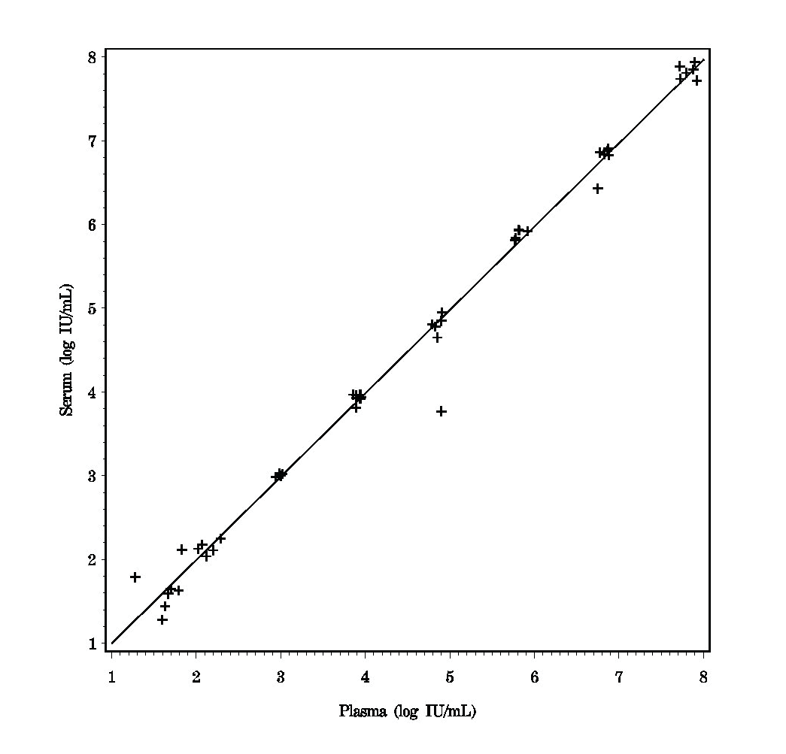
Performance of the Assay with HCV-Negative Specimens
The specificity of the Abbott RealTime HCV assay was evaluated by analyzing 760 unique HCV negative specimens; 380 plasma specimens and 380 serum specimens. HCV RNA was detected in two of the specimens tested. The observed specificity for this study was 99.74% (758/760) (95% CI 99.05 to 99.97%).
Analytical Carryover
Potential sample carryover within the Abbott RealTime HCV assay was evaluated by testing 372 high titer HCV positive samples (Abbott RealTime HCV Calibrator B with a
Table 13 Abbott RealTime HCV
Specimen Stability (Log IU/mL)
Test
Baseline
Sample Type
Test Condition
Condition Mean
Condition Mean
Mean Difference
Whole Blood (Plasma)
6 hours at 28 to 32ºC
3.132
3.129
0.003
target concentration of 7.00 log IU/mL) interspersed with 372 negative samples (Abbott |  | 6 hours at 2 to 8ºC | 3.077 | 3.129 | -0.052
RealTime HCV Negative Control). The Abbott RealTime HCV assay did not exhibit _{Whole Blood} |  | 6 hours at 28 to 32ºC | 3.042 | 3.082 | -0.040
for percent carryover was 0.99%. | ^{(Serum)} 6 hours at 2 to 8ºC |  | 3.058 | 3.082 | -0.024
Serum vs. Plasma Across the Linear Range | 24 hours at 28 to 32ºC^{b} |  | 2.662 | 2.939 | -0.277
detectable carryover from high positive samples to negative samples. The upper 95% CI
HCV serologically negative specimens from donors were collected as serum and as plasma in tubes and spiked with an HCV viral stock or with an Armored HCV RNA stock to HCV RNA concentrations across the linear range for a total of 50 matched pairs. The HCV RNA concentration from the plasma and the serum specimens were compared.
The mean difference between serum and plasma specimens was -0.02 log IU/mL (95% CI -0.08 to 0.04%). The results are presented in Figure 5.
Figure 5 Abbott RealTime HCV
Serum vs Plasma Across the Linear Range
72 hours at 2 to 8ºC
24 hours at 28 to 32ºC,^{b}
48 hours at 2 to 8ºC
2.872
2.939
-0.067
2.601
2.939
-0.338
Plasma
60 days at -10 to -30ºC, thaw at 2 to 8ºC | 2.597 | 2.750 | -0.153
60 days at ≤70ºC, thaw at 2 to 8ºC | 2.603 | 2.750 | -0.147
freeze/thaw cyclesª,
hours at 2 to 8ºC
2.728
2.733
-0.005
y = 1.00x + 0.00 r = 0.995
n = 50
24 hours at 28 to 32ºC^{b}
72 hours at 2 to 8ºC
24 hours at 28 to 32ºC,^{b}
48 hours at 2 to 8ºC
2.572
2.869
2.902
2.902
-0.330
-0.033
2.478
2.902
-0.424
Serum
60 days at -10 to -30ºC, thaw at 2 to 8ºC | 2.743 | 2.903 | -0.160
60 days at ≤70ºC,
thaw at 2 to 8ºC | 2.853 | 2.903 | -0.050
5 freeze/thaw cyclesª,
6 hours at 2 to 8ºC | 2.774 | 2.705 | 0.069
< –70ºC / thaw at 28 to 32ºC.
ª freeze at
^{b} 28 to 32ºC represents the upper range of room temperature exposure.
CLINICAL STUDIES
Study Population
Retrospectively collected specimens from subjects enrolled in fourteen different multi- center clinical trials were studied. The study population consisted of 356 evaluable chronic hepatitis C (CHC) infected subjects, treated with pegylated interferon alfa 2a or 2b and ribavirin combination therapy.
For site 1, a total of 160 treatment naive, HCV genotype 1, 2, and 3 subjects were enrolled from two European, Phase IV, treatment, safety and efficacy studies.
For site 2, a total of 200 treatment naive, HCV genotype 1 and 2 subjects were enrolled from ten investigator-initiated trials from two hospitals in Asia. Forty three subjects did not meet inclusion/exclusion criteria leaving 157 evaluable subjects.
For site 3, a total of 46 CHC subjects, HCV genotype 1, 2, and 3, treated by standard of care at Liver Clinics at two US Medical Centers, were enrolled from two genetic studies. Seven subjects did not meet inclusion/exclusion criteria leaving 39 evaluable subjects.
Determination of HCV RNA viral levels at Screening, Baseline, Week 4, and Week 12 were performed using the Abbott RealTime HCV Assay.
Two predictive analyses were established from the study population based on the availability of specimens at clinically relevant time points as follows: Week 4/RVR Analysis was performed for the subset of subjects with viral load results available for Week 4, EOT, and EOF time points, and Week 12/EVR Analysis was performed for the subset of subjects with viral load results available for Baseline, Week 12, EOT, and EOF time points. Baseline demographics of the overall study population and each site are presented in Table 14.
There were no samples from subjects with HCV genotypes 4, 5, and 6 tested in clinical studies with the Abbott RealTime HCV Assay. Therefore, the non-1 genotype label used in Table 14 and subsequent tables refers to genotypes 2 and 3.
For Information Only - Not a Controlled Copy
Specimen Stability
Specimen stability testing for HCV in whole blood, serum, and plasma was performed. For each test condition, samples from ten unique donors were spiked with HCV virions at a target concentration of 1,000 IU/mL. The samples were divided into aliquots and stored at the test conditions listed in Table 13.
Freshly drawn specimens (whole blood) may be held at 2 to 30°C for up to 6 hours prior to centrifugation.
Serum or plasma specimens may be stored at 15 to 30°C for up to 24 hours, 2 to 8°C for up to 3 days, -10 to -30°C for 60 days, or -70°C or colder for 60 days.
Multiple freeze/thaw cycles should be avoided and should not exceed three freeze/thaw cycles. Frozen specimens may be thawed at 15 to 30°C or 2 to 8°C. Thawed specimens may be stored at 2 to 8°C for up to 6 hours, if not processed immediately. Serum and plasma specimens may be stored at -10°C or colder for 60 days.

Slide 14
Table 14 Subject Demographics
Table 15
Within Subject Variability
Characteristics | Category | Number of Subjects (n) | Percentage of Total
Total Number of Subjects |  | 356 | 100.0
Age | < 40 years | 52 | 14.6
 | ≥ 40 years | 304 | 85.4
Gender | Female | 172 | 48.3
 | Male | 184 | 51.7
Race/Ethnicity | Asian | 163^{b} | 45.8
 | Black | 3 | 0.8
 | Caucasian | 180 | 50.6
 | Hispanic / Latino | 5 | 1.4
 | Not available | 5 | 1.4
Genotype | 1 | 231^{c} | 64.9
 | 2 | 96 | 27.0
 | 3 | 29^{d} | 8.1
Baseline HCV RNA Genotype 1ª | ≤ 8.0 x 10⁵ IU/mL | 138 | 59.7
 | > 8.0 x 10⁵ IU/mL | 90 | 39.0
 | Missing | 3 | 1.3
Baseline HCV RNA Genotype Non-1ª | ≤ 8.0 x 10⁵ IU/mL | 104 | 83.2
 | > 8.0 x 10⁵ IU/mL | 20 | 16.0
 | Missing | 1 | 0.8
Baseline Biopsy Result | Cirrhotic | 30 | 8.4
 | Non-Cirrhotic | 326 | 91.6
Genotype | n | Total Assay Variability SDª | Biological Variability SDª | Within Subject Variability SDª
1 | 142 | 0.06 | 0.33 | 0.34
Non-1 | 8 | 0.06 | 0.50 | 0.50
ª Standard deviations are in log IU/mL.
Predictive Analysis
Association Between Baseline Covariates and Sustained Virologic Response Odds ratios (OR) and 95% confidence intervals (95% CI) were calculated for established host- and viral- baseline covariates predictive of SVR with peginterferon/
ribavirin combination therapy. The statistical significance of the associations of Age, Gender, Genotype, Baseline HCV RNA level, and Baseline Liver Biopsy result are summarized in Table 16.
The data used for this analysis comprises 356 subjects who have baseline characteristics and treatment outcome. For all sites combined, genotype (Non-1) and baseline biopsy result (Non-Cirrhotic) had a significant influence on achieving SVR. HCV genotype (Non-1) odds ratio equals 2.93 (95% CI 1.56, 5.81) and baseline biopsy result odds ratio equals 2.48 (95% CI 1.03, 5.74).
Table 16
Predictors of Sustained Virologic Response at Baseline
Characteristics | Category | n | Percent with SVR | Odds Ratio (95% CI) Using Univariate Analysis
Age | < 40 years | 52 | 86.54 | 2.07 (0.87, 5.66)
 | ≥ 40 years | 304 | 75.66
Gender | Male | 184 | 77.72 | 1.06 (0.62, 1.79)
 | Female | 172 | 76.74
Genotype | 1 | 231 | 71.43 | 2.93 (1.56, 5.81)
 | Non-1^{b} | 125 | 88.00
Baseline HCV RNA for Genotype 1ª | ≤ 8.0 x 10⁵ IU/mL | 138 | 76.09 | 1.84 (0.99, 3.43)
 | > 8.0 x 10⁵ IU/mL | 90 | 63.33
Baseline HCV RNA for Genotype Non-1ª | ≤ 8.0 x 10⁵ IU/mL | 104 | 89.42 | 2.11 (0.43, 8.29)
 | > 8.0 x 10⁵ IU/mL | 20 | 80.00
Baseline Biopsy Result | Cirrhotic | 30 | 60.00 | 2.48 (1.03, 5.74)
 | Non-Cirrhotic^{b} | 326 | 78.83
ª 8.0 x 10⁵ IU/mL = 5.90 log IU/mL based upon Test of Record.
^{b} One subject’s race/ethnicity was Asian and Caucasian mixed and was categorized as Asian.
^{c} One subject’s HCV genotype from Site 2 was 1b/2b and was treated as a genotype 1. ^{d} One subject from Site 1 was co-infected with HCV genotypes 1a and 3a and was treated as a non-1 genotype.
^{e} Genotype Non-1 in this table and subsequent tables refers to genotypes 2 and 3 and does not include genotypes 4, 5, and 6.
Clinical Study Results and Statistical Analysis
The use of HCV RNA quantitation for the on-treatment assessment of HCV antiviral therapy has become an increasingly important tool for individualizing treatment and optimizing patient outcomes. The critical on-treatment time points for evaluating therapy for customization or discontinuation are at Weeks 4 and 12.
The primary objective of this study was to evaluate the clinical utility of the Abbott RealTime HCV Assay for the clinical management of patients infected with chronic hepatitis C (CHC) by estimating the Negative Predictive Value (NPV) and Positive Predictive Value (PPV) for achieving sustained virologic response (SVR) at established clinically relevant time points during antiviral treatment (Week 4/RVR and Week 12/ EVR).
Definitions of Prediction Rules, NPV, PPV, and Odds Ratios:
Rapid Virologic Response (RVR) Analysis = HCV RNA <LOD (12 IU/mL or 1.08 log IU/mL) at Week 4 antiviral therapy.
Early Virologic Response (EVR) = achievement of a 2-log drop or greater of HCV RNA or HCV RNA negative at Week 12 of antiviral therapy.
Sustained Virologic Response (SVR) = HCV RNA negative 24 weeks after cessation of treatment.
ǟ Undetermined SVR status = Shortened treatment duration or missing EOT / EOF time points with recommended treatment duration.
Positive Predictive Value (PPV) = the probability of SVR given an on-treatment virologic response at Week 4 and 12.
Negative Predictive Value (NPV) = the probability of not achieving SVR given no on-treatment virologic response at Week 4 or 12.
Odds Ratio (OR) describes the measure of association between virologic response and SVR. Factors such as HCV genotype, baseline viral load, cirrhosis, age, and gender are cited in the literature as predictors for SVR. The relationship between SVR and RVR or EVR results was studied after adjusting for baseline covariates.
Data from the three study sites were analyzed for both PPV and NPV as pooled data and further stratified by genotype.
Within Subject Variability in Absence of Treatment
The objective of this analysis is to estimate the relative contributions of biological variability and assay variability to within subject HCV RNA variability in the absence of treatment.
One-hundred fifty subjects had both screening and baseline results. These two results were used to estimate within subject variability, which includes biological variability as well as total assay variability. The total assay variability, biological variability, and within subject variability from these results were estimated and are shown in Table 15.
For Information Only - Not a Controlled Copy
ª 352 of the 356 subjects have both baseline HCV RNA and treatment outcome. ^{b} The significance of genotype (Non-1) and baseline biopsy result (Non-Cirrhotic) predicting SVR is demonstrated by the lower 95% CI limit for the odds ratio exceeding 1.0.
Predictive Values at Week 4 of Antiviral Therapy (RVR Analysis)
The following RVR analysis was performed using HCV RNA < 12 IU/mL as the prediction rule.
The PPV and NPV and all associated two sided 95% CI, of RVR for SVR (as determined by test of record) were calculated on treatment outcomes in CHC subjects and is summarized in Table 17.
For all sites combined, the results demonstrate a high PPV for all subjects at 4 weeks independent of genotype. CHC genotype 1 subjects with RVR had a 100.0% (64/64) probability to achieve SVR (odds ratio > 36.6) and hepatitis C genotype non-1 subjects with RVR had a 93.3% (84/90) probability to achieve SVR (odds ratio 6.5, 95% CI 1.6, 26.6). The significance of a rapid virologic response at Week 4 in predicting SVR is demonstrated by the lower 95% CI limit for the odds ratio exceeding 1.0.
CHC genotype 1 subjects who had not achieved RVR had a 36.8% (57/155) probability of not achieving SVR and hepatitis C genotype non-1 subjects who had not achieved RVR had a 31.8% (7/22) probability of not achieving SVR.
In this analysis, RVR has high reliability as a positive predictor for determining if CHC subjects will achieve SVR and low reliability as a negative predictor for determining if CHC subjects will not achieve SVR.

Slide 15
Table 17
NPV and PPV at Week 4 (RVR) and Corresponding Odds Ratios
Conclusions Drawn from the Studies
The use of HCV RNA quantitation for the on-treatment assessment of HCV antiviral therapy has become an increasingly important tool for individualizing treatment and optimizing patient outcomes. The critical on-treatment time points for evaluating therapy for customization or discontinuation are at Weeks 4 and 12.
RVR measured by the Abbott RealTime HCV assay, using HCV RNA < 12 IU/mL as the prediction rule demonstrated high reliability as a positive predictor of a SVR. Genotype 1 subjects with RVR had a 100.0% (64/64) probability (PPV) to achieve SVR and hepatitis C genotype non-1 subjects with RVR had a 93.3% (84/90) probability (PPV) to achieve SVR.
EVR demonstrated high reliability as a negative predictor for SVR. Genotype 1 subjects who had not achieved EVR had a 91.9% (34/37) probability (NPV) of not achieving SVR and hepatitis C genotype non-1 subjects who had not achieved EVR had a 100.0% (4/4) probability (NPV) of not achieving SVR.
Based on the results of the nonclinical and clinical laboratory studies, the Abbott RealTime HCV assay can be used as an aid in the management of HCV-infected patients undergoing antiviral therapy and can be utilized to predict sustained virological response and non-response. The assay can be used to quantitatively measure HCV RNA levels in human serum or plasma at baseline and during treatment. The study supports the use of the Abbott RealTime HCV assay for determining RVR and EVR.
Genotype | NPVª (%) (95% CI) | PPV^{b} (%) (95% CI) | Odds Ratio (95% CI)
 |  |  | Unadjusted (95% CI) | Adjusted (95% CI)^{c}
1 | 57/155^{d} (36.8) (34.1, 40.0) | 64/64 (100.0) (94.7, 100.0) | > 36.6e (N/A^{f}) | 71.1 (4.6, > 999.9)
Non-1 | 7/22 (31.8) (16.7, 46.8) | 84/90^{g} (93.3) (90.0, 96.6) | 6.5 (1.6, 26.6) | 4.9 (1.5 16.6)
ª NPV: Denominator is the number of subjects with no RVR at 4 weeks; the numerator is the number of subjects who did not achieve SVR among subjects with no RVR at 4 weeks.
^{b} PPV: Denominator is the number of subjects with RVR at 4 weeks; the numerator is the number of subjects who did achieve SVR among subjects with RVR.
^{c} Based on the logistic regression model including covariates gender (male vs. female), baseline viral load (≤8.0 x 10⁵ IU/mL vs. >8.0 x 10⁵ IU/mL), liver disease (cirrhotic vs. non-cirrhotic), and age (<40 vs. ≥40).
^{d} 8 of 155 subjects who did not achieve RVR and who had undetermined SVR status were assigned “SVR achieved” status for this analysis.
^{e} The odds ratio calculations are undefined when NPV is 100% or PPV is 100% or missing. Where the denominators for both the NPV and PPV are greater than five, a “minimum” odds ratio was determined by subtracting one specimen from the numerator of the 100% parameter estimate (NPV or PPV).
^{f} N/A = not applicable.
^{g} 2 of 90 subjects who did achieve RVR and who had undetermined SVR status were assigned “SVR not achieved” status for this analysis.
Similarly, RVR analysis based upon < 50 IU/mL as the prediction rule demonstrated high reliability as a positive predictor of SVR. Overall CHC genotype 1 subjects with RVR had a 98.7% (76/77) probability to achieve SVR (unadjusted odds ratio = 49.5) and hepatitis C genotype non-1 subjects with RVR had a 91.9% (91/99) probability to achieve SVR (unadjusted odds ratio = 7.1).
Predictive Values at Week 12 of Antiviral Therapy (EVR Analysis)
The PPV and NPV and all associated two sided 95% confidence intervals for EVR were calculated on the reliability of EVR to predict SVR (as determined by test of record) after completion of therapy in CHC subjects and is summarized in Table 18.
CHC genotype 1 subjects who had not achieved EVR had a 91.9% (34/37) probability (NPV) of not achieving SVR and hepatitis C genotype non-1 subjects who had not achieved EVR had a 100.0% (4/4) probability (NPV) of not achieving SVR.
CHC genotype 1 subjects with EVR had a 80.2% (154/192) probability (PPV) to achieve SVR (odds ratio 45.9, 95% CI 13.1, 240.8) and hepatitis C genotype non-1 subjects with EVR had a 91.6% (109/119) probability (PPV) to achieve SVR (odds ratio >32.7). The significance of an early virologic response at Week 12 in predicting SVR is demonstrated by the lower 95% CI limit for the odds ratio exceeding 1.0.
In this analysis, EVR has high reliability as a negative predictor for determining if CHC subjects will achieve SVR.
Table 18
NPV and PPV at Week 12 (EVR) and Corresponding Odds Ratios
For Information Only - Not a Controlled Copy
Genotype | NPVª (%) (95% CI) | PPV^{b} (%) (95% CI) | Odds Ratio (95% CI)
 |  |  | Unadjusted (95% CI) | Adjusted (95% CI)^{c}
1 | 34/37^{d} (91.9) (79.4, 97.4) | 154/192e (80.2) (76.9, 83.8) | 45.9 (13.1, 240.8) | 53.7 (13.9, 207.7)
Non-1 | 4/4 (100.0) (51.2, 100.0) | 109/119^{f} (91.6) (89.7, 94.8) | > 32.7^{g} (N/A^{h}) | 118.5 (4.0, > 999.9)
ª NPV: Denominator is the number of subjects with no EVR at 12 weeks; the numerator is the number of subjects who did not achieve SVR among subjects with no EVR at 12 weeks.
^{b} PPV: Denominator is the number of subjects with EVR at 12 weeks; the numerator is the number of subjects who did achieve SVR among subjects with EVR.
^{c} Based on the logistic regression model including covariates gender (male vs. female), baseline viral load (≤8.0 x 10⁵ IU/mL vs. >8.0 x 10⁵ IU/mL), liver disease (cirrhotic vs. non-cirrhotic), and age (<40 vs. ≥40).
^{d} 2 of 37 subjects who did not achieve EVR and who had undetermined SVR status were assigned “SVR achieved” status for this analysis.
^{e} 8 of 192 subjects who did achieve EVR and who had undetermined SVR status were assigned “SVR not achieved” status for this analysis.
^{f} 2 of 119 subjects who did achieve EVR and who had undetermined SVR status were assigned “SVR not achieved” status for this analysis.
^{g} The odds ratio calculations are undefined when NPV is 100% or PPV is 100% or missing. Where the denominators for both the NPV and PPV are greater than five, a “minimum” odds ratio was determined by subtracting one specimen from the numerator of the 100% parameter estimate (NPV or PPV).
^{h} N/A = not applicable.

Slide 16
BIBLIOGRAPHY
THE PURCHASE OF THIS PRODUCT ALLOWS THE PURCHASER TO USE IT FOR AMPLIFICATION OF NUCLEIC ACID SEQUENCES AND FOR DETECTION OF NUCLEIC ACID SEQUENCES FOR HUMAN IN VITRO DIAGNOSTICS. NO GENERAL PATENT OR OTHER LICENSE OF ANY KIND OTHER THAN THIS SPECIFIC RIGHT OF USE FROM PURCHASE IS GRANTED HEREBY. THIS PROVISION DOES NOT PROHIBIT THE RESALE OF THIS PRODUCT.
This product is not to be used for testing or screening pooled samples containing specimens from more than one individual, or otherwise in blood or plasma screening. This product is licensed from Novartis Vaccines and Diagnostics, Inc. and is covered by one or more of the following U.S. patents 5,714,596; 5,712,088; 5,863,719; 5,372,928;
5,851,759; 6,074,816 and their foreign equivalents.
Armored RNA® is a patented technology jointly developed by Ambion, Inc. and Cenetron Diagnostics, LLC. U.S. patents #5,677,124, #5,919,625, #5,939,262 and patents pending.
Clarke B. Molecular virology of hepatitis C virus. J. Gen. Virol 1997;78:2397-410.
Armstrong GL, Wasley A, Simard EP, et al. The prevalence of Hepatitis C Virus infection in the United States, 1999 through 2002. Ann Intern Med 2006;144:705-14.
EASL International Consensus Conference on Hepatitis C. Consensus Statement. J. Hepatol 1999;30:956-61.
NIH Consensus and State-of-the-Science Statements. Management of Hepatitis C: 2002;19(3):1-46.
McHutchison JG, Gordon SC, Schiff ER, et al. Interferon alfa-2b alone or in combination with ribavirin as initial treatment for chronic hepatitis C. N Engl J Med 1998;339(21):1485-92.
Davis GL, Esteban-Mur R, Rustgi V, et al. Interferon alfa-2b alone or in combination with ribavirin for the treatment of relapse of chronic hepatitis C. N Engl J Med 1998;339(21):1493-9.
Manns MP, McHutchison JG, Gordon SC, et al. Peginterferon alfa-2b plus ribavirin compared with interferon alfa-2b plus ribavirin for initial treatment of chronic hepatitis C: a randomised trial. Lancet 2001;358:958-65.
Fried MW, Shiffman ML, Reddy KR, et al. Peginterferon alfa-2a plus ribavirin for chronic hepatitis C virus infection. N Engl J Med 2002;347(13):975-82.
Hadziyannis SJ, Sette H Jr., Morgan TR, et al. Peginterferon-[alpha] 2a and ribavirin combination therapy in chronic hepatitis C: a randomized study of treatment duration and ribavirin dose. Ann Intern Med 2004;140(5):346-55.
Abbott m, m2000, m2000sp and m2000rt are trademarks of Abbott Laboratories. Armored RNA is a registered trademark of Ambion.
ProClin is a registered trademark of Rohm and Haas. FAM and ROX are trademarks of Life Technologies. VIC is a registered trademark of Life Technologies.
Ghany MG, Strader DB, Thomas DL, et al. Diagnosis, management, and treatment of hepatitis C: an update. Heptatology 2009;49 (4):1335-74.
Jensen DM, Morgan TR, Marcellin P, et al. Early identification of HCV genotype 1 patients responding to 24 weeks peginterferon alpha-2a (40 kd)/ribavirin therapy. Hepatology 2006;43(5):954-60.
Abbott Molecular Inc. is the legal manufacturer of the:
Abbott RealTime HCV Amplification Reagent Kit (List No. 1N30-90); Abbott RealTime HCV Control Kit (List No. 1N30-80); and
Abbott RealTime HCV Calibrator Kit (List No. 1N30-70).
Berg T, von Wagner M, Nasser S, et al. Extended treatment duration for hepatitis C virus type 1: comparing 48 versus 72 weeks of pegintrferon-alfa-2a plus ribavirin. Gastroenterology 2006;130(4):1086-1097.
Pearlman BL, Ehleben C, Saifee S. Treatment extension to 72 weeks of peginterferon and ribavirin in hepatitis c genotype 1-infected slow responders. Hepatology 2007;46(6):1688-94.
Sanchez-Tapias JM, Diago M, Escartin P, et al. Peginterferon-alfa2a plus ribavirin for 48 versus 72 weeks in patients with detectable hepatitis C virus RNA at week 4 of treatment. Gastroenterology 2006;131(2):451-60.
Germer JJ, Harmsen WS, Mandredkar JN, et al. Evaluation of the COBAS TaqMan HCV test with automated sample processing using MagNA pure LC instrument. J Clin Microbiol 2005;43(1):23-8.
Saldanha J, Heath A, Aberham A, et al. World Health Organization collaborative study to establish a replacement WHO international standard for hepatitis C virus RNA nucleic acid amplification technology assays. Vox Sang 2005;88:202-4.
Myers TW, Gelfand DH. Reverse Transcription and DNA amplification by a Thermus thermophilus DNA polymerase. Biochem 1991;30(31):7661-6.
Smith DB, Mellor J, Jarvis LM, et al. Variation of the hepatitis C virus 5´non-coding region: implications for secondary structure, virus detection and typing. The International HCV Collaborative Study Group. J Gen Virol 1995;76(Pt7):1749-61.
US Department of Health and Human Services. Biosafety in Microbiological and Biomedical Laboratories, Fifth Edition. Washington, DC: US Government Printing Office; December 2009.
US Department of Labor, Occupational Safety and Health Administration, 29 CFR Part 1910.1030, Occupational Exposure to Bloodborne Pathogens.
World Health Organization. Laboratory Biosafety Manual. Geneva: World Health Organization; 2004.
Clinical and Laboratory Standards Institute. Protection of Laboratory Workers from Occupationally Acquired Infections: Approved Guideline -Third Edition. CLSI Document M29-A3. Wayne, PA: Clinical and Laboratory Standards Institute, 2005.
Sehulster LM, Hollinger FB, Dreesman GR, et al. Immunological and biophysical alteration of hepatitis B virus antigens by sodium hypochlorite disinfection. Appl. Envir Microbio 1981;42(5):762-7.
CDC. Guidelines for the prevention of human immunodeficiency virus and hepatitis B virus to health-care and public-safety workers. MMWR 1989; 38(S-6): 16S.
Clinical and Laboratory Standards Institute. Clinical Laboratory Waste Management: Approved Guideline –Second Edition. CLSI Document GP5-A2. Wayne, PA: CLSI, 2002;22(3):1-23,32-44.
US Environmental Protection Agency. EPA Guide for Infectious Waste Management Publication No.EPA/530-SW-86-014. Washington, DC: US Environmental Protection Agency, 1986:1-1 – 5-5, R1-R3, A1-A24.
Clinical and Laboratory Standards Institute. Evaluation of the Linearity of Quantitative Measurement Procedures: A Statistical Approach; Approved Guideline. CLSI Document EP6-A. CLSI: Wayne, PA; 2002.
Clinical and Laboratory Standards Institute. Protocols for Determination of Limits of Detection and Limits of Quantitation; Approved Guideline. CLSI Document EP17-A. CLSI: Wayne, PA; 2008.
www.abbottmolecular.com
©2011 Abbott Laboratories May 2011
For Information Only - Not a Controlled Copy
Abbott Molecular Inc.
Des Plaines, IL 60018 USA

